Slide 1
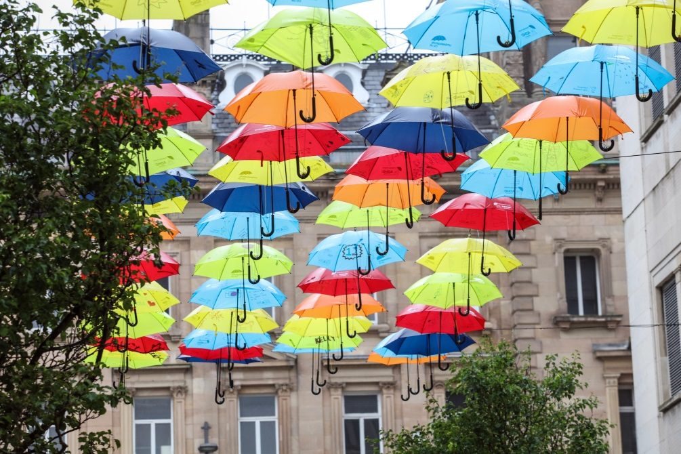
Umbrella Project 2018

Slide 3
What is ADHD?
Attention
Deficit
Hyperactivity
Disorder

Slide 4
People with ADHD can find it difficult to …
Organise their work
Sit still
Concentrate
Manage their emotions
Remember things

Slide 5
Source: www.adhdvoices.com

Slide 6
What is ASC?
Autism
Spectrum
Condition

Slide 7
People with ASC can find it difficult to …
Make friends
Play with lots of children
Manage their emotions
Look at your face
Understand instructions

Slide 8
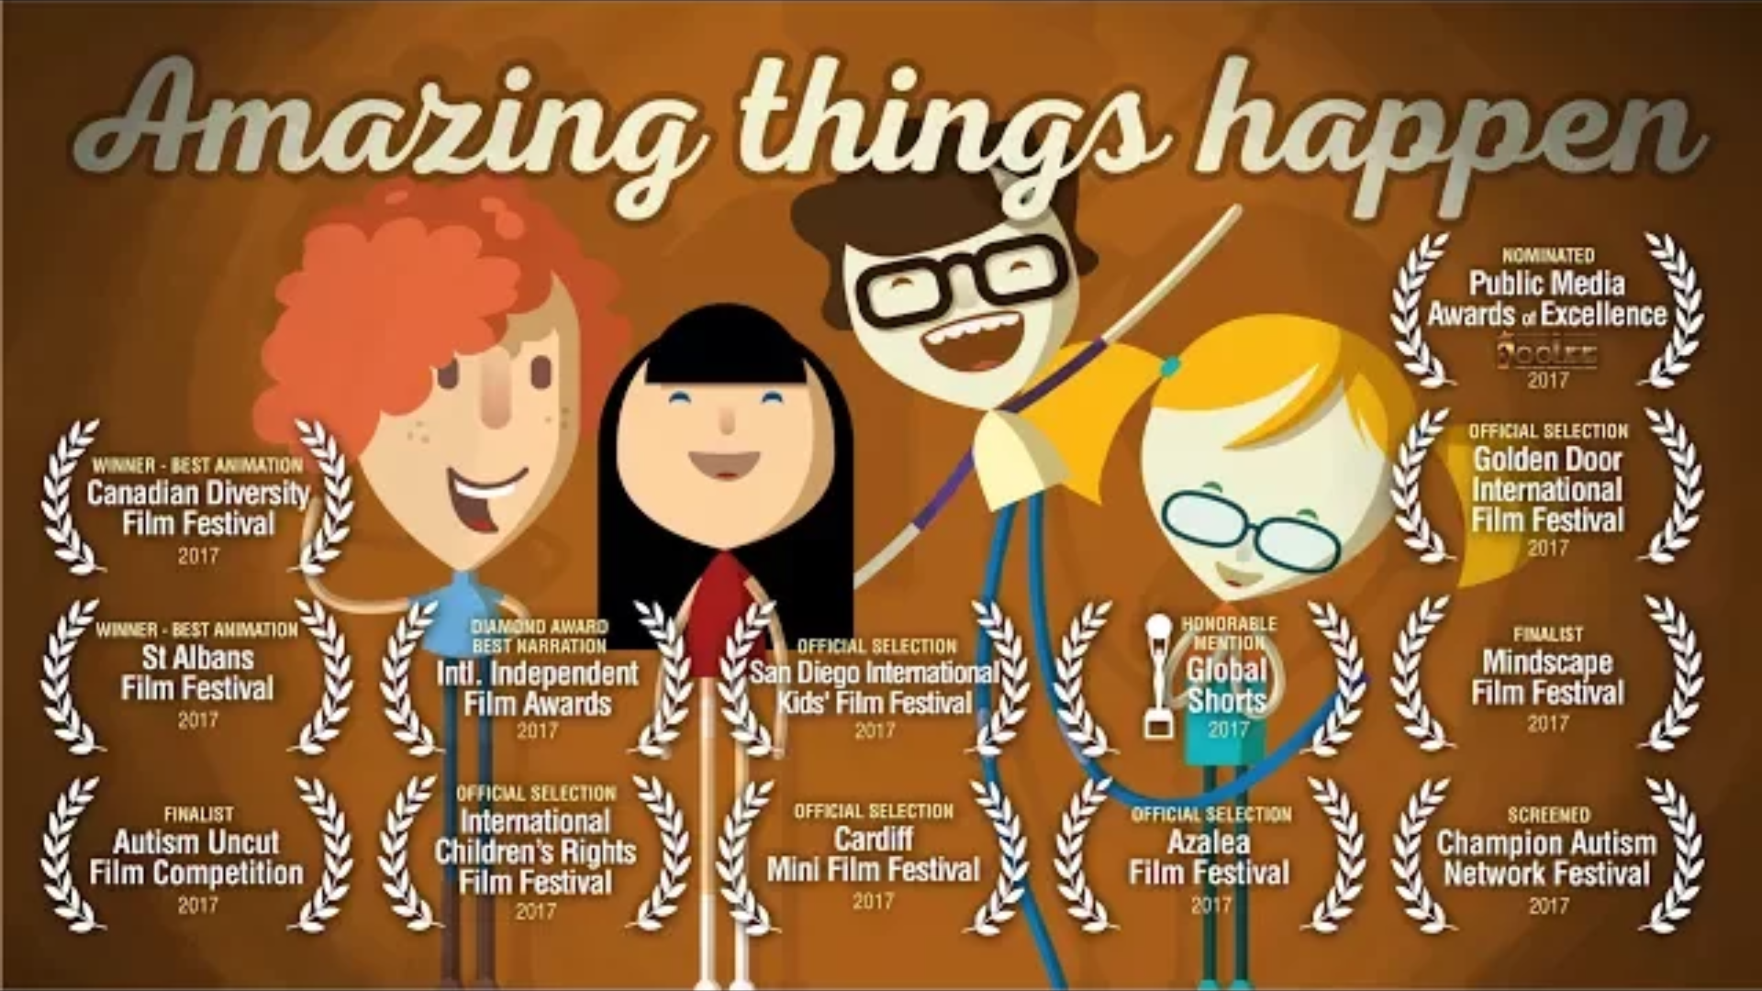
Source: http://amazingthingshappen.tv/

Slide 9
People with ADHD and ASC are …
Creative
Fun to be with
Fearless
Kind
Funny
Great friends
Driven
Intelligent
Imaginative
Quick witted
Enthusiastic
Courageous

Slide 10
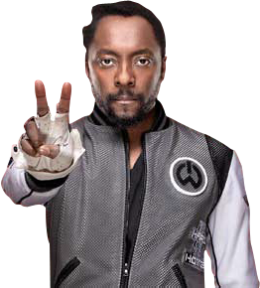
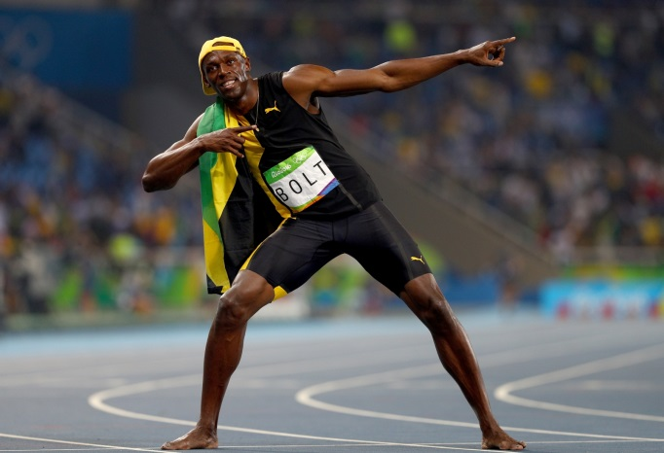
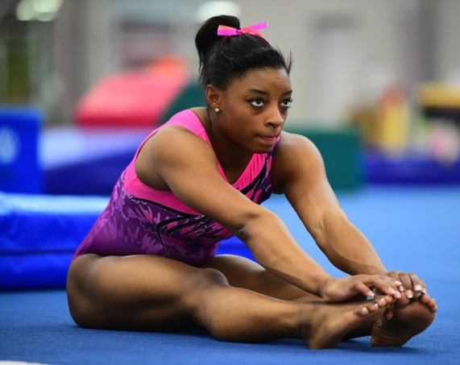
People you may know …
Usain Bolt
He’s a world record holder!
Will.i.am
Music is his Superpower
Simone Biles
She’s an Olympic Gold medal winner in Gymnastics

Slide 11
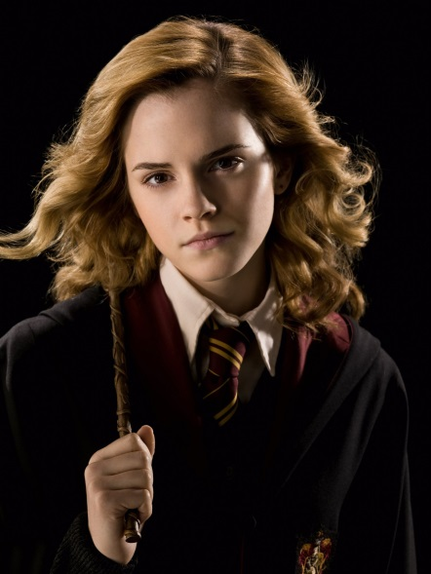
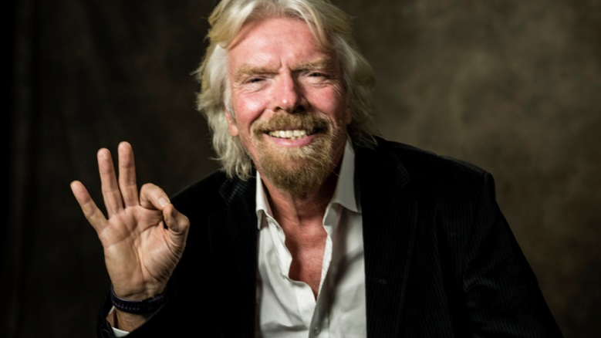
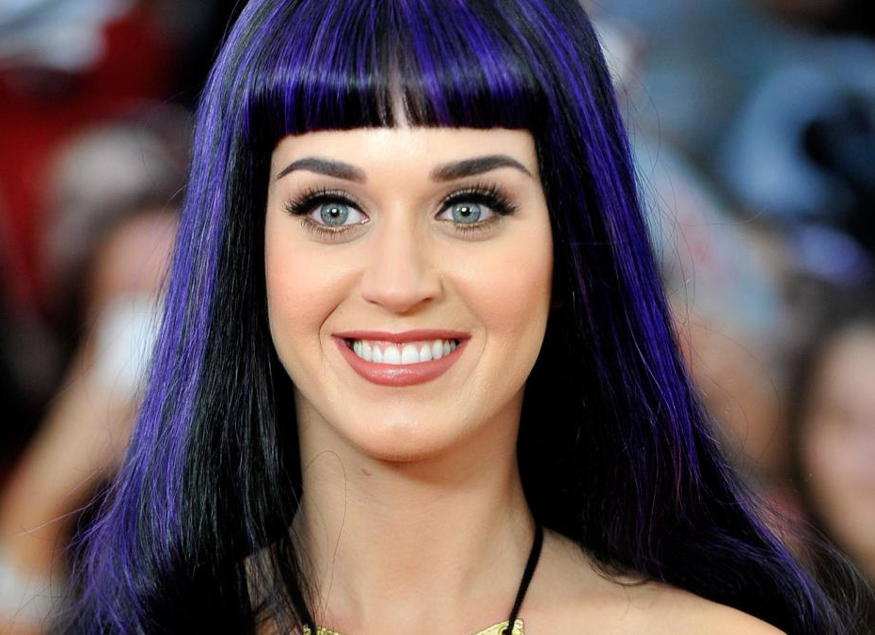
People you may know …
Emma Watson
She’s an actress in Harry Potter
Richard Branson
He has a Superpower in business
Katy Perry
She’s a famous singer!

Slide 12
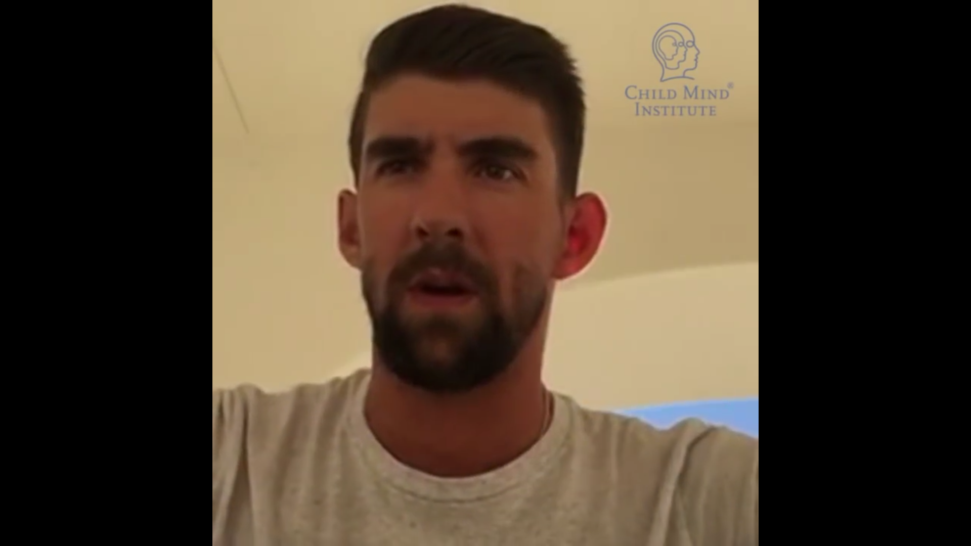
Source: https://speakupforkids.org

Slide 13
Find your Superpower

