Slide 1
Umbrella Project 2018

Slide 3
People with ADHD can find it difficult to …
Organise their work
Sit still
Concentrate
Manage their emotions
Remember things

Slide 4
What is ADHD?
Attention Deficit Hyperactivity Disorder
Neurodevelopmental
Condition
Effects 11% of
Young People
A lifelong condition

Slide 5
What’s it like to have ADHD?

Slide 6
What is ASC?
Autism Spectrum Condition
Effects 700,000 people in the UK
It effects a person’s
social communication
It’s a lifelong condition

Slide 7
People with ASC can find it difficult to …
Make friends
Understand social rules
Manage their emotions
Cope with the environment
Understand instructions

Slide 8
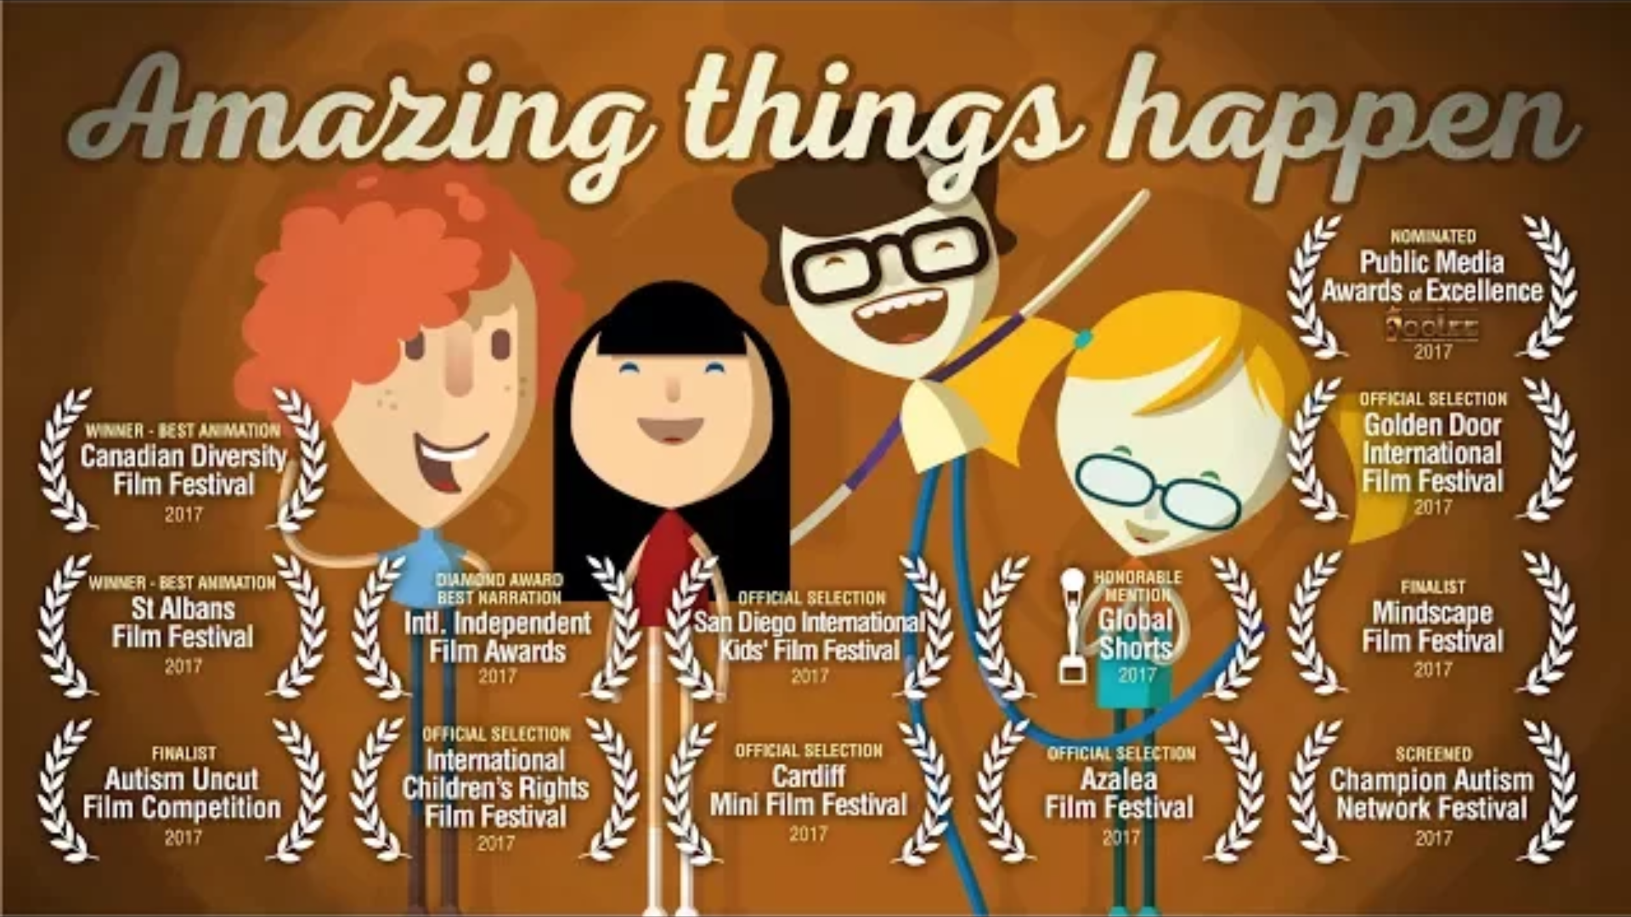
Make friends
Source: http://amazingthingshappen.tv/

Slide 9
People with ADHD and ASC are …
Creative
Fun to be with
Fearless
Kind
Funny
Great friends
Driven
Intelligent
Imaginative
Quick witted
Enthusiastic
Courageous

Slide 10
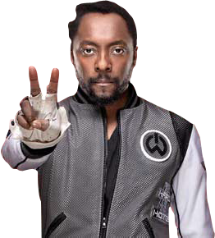
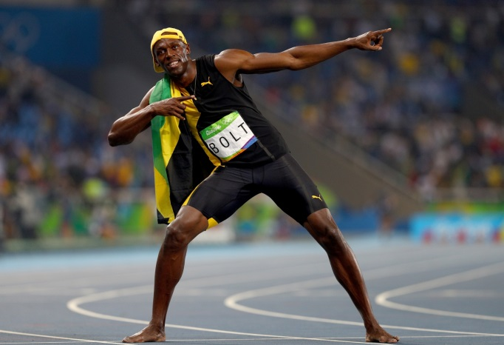
People you may know …
Usain Bolt
He’s a world record holder!
Will.i.am
World renowned music producer
Simone Biles
She’s an Olympic Gold medal winner in Gymnastics

Slide 11
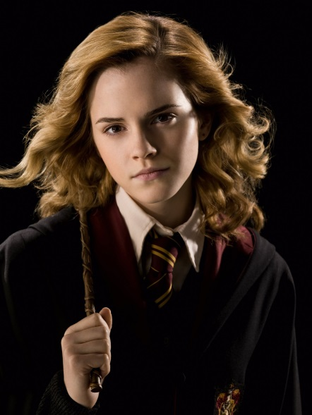
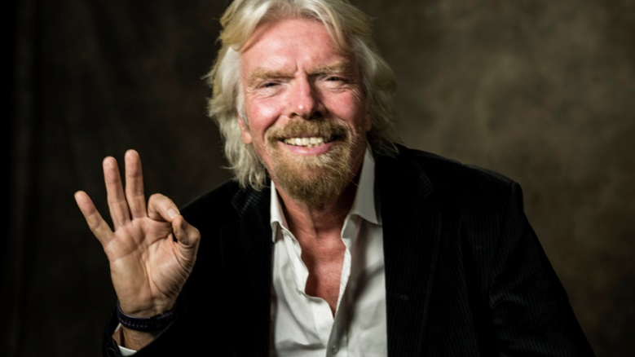
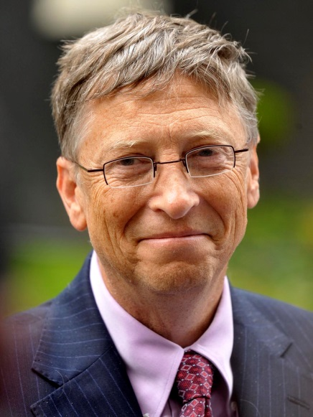
People you may know …
Emma Watson
She’s an actress in Harry Potter
Richard Branson
He has a Superpower in business
Bill Gates
He created Microsoft

Slide 12
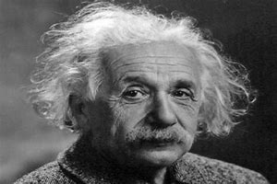
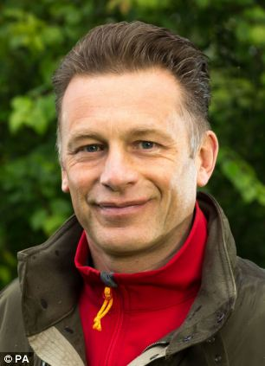
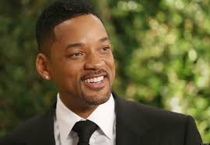
People you may know …
It was thought that Albert Einstein had ASC
Chris Packam
He has a real passion for nature
Will Smith
He’s starred in lots of films

Slide 13
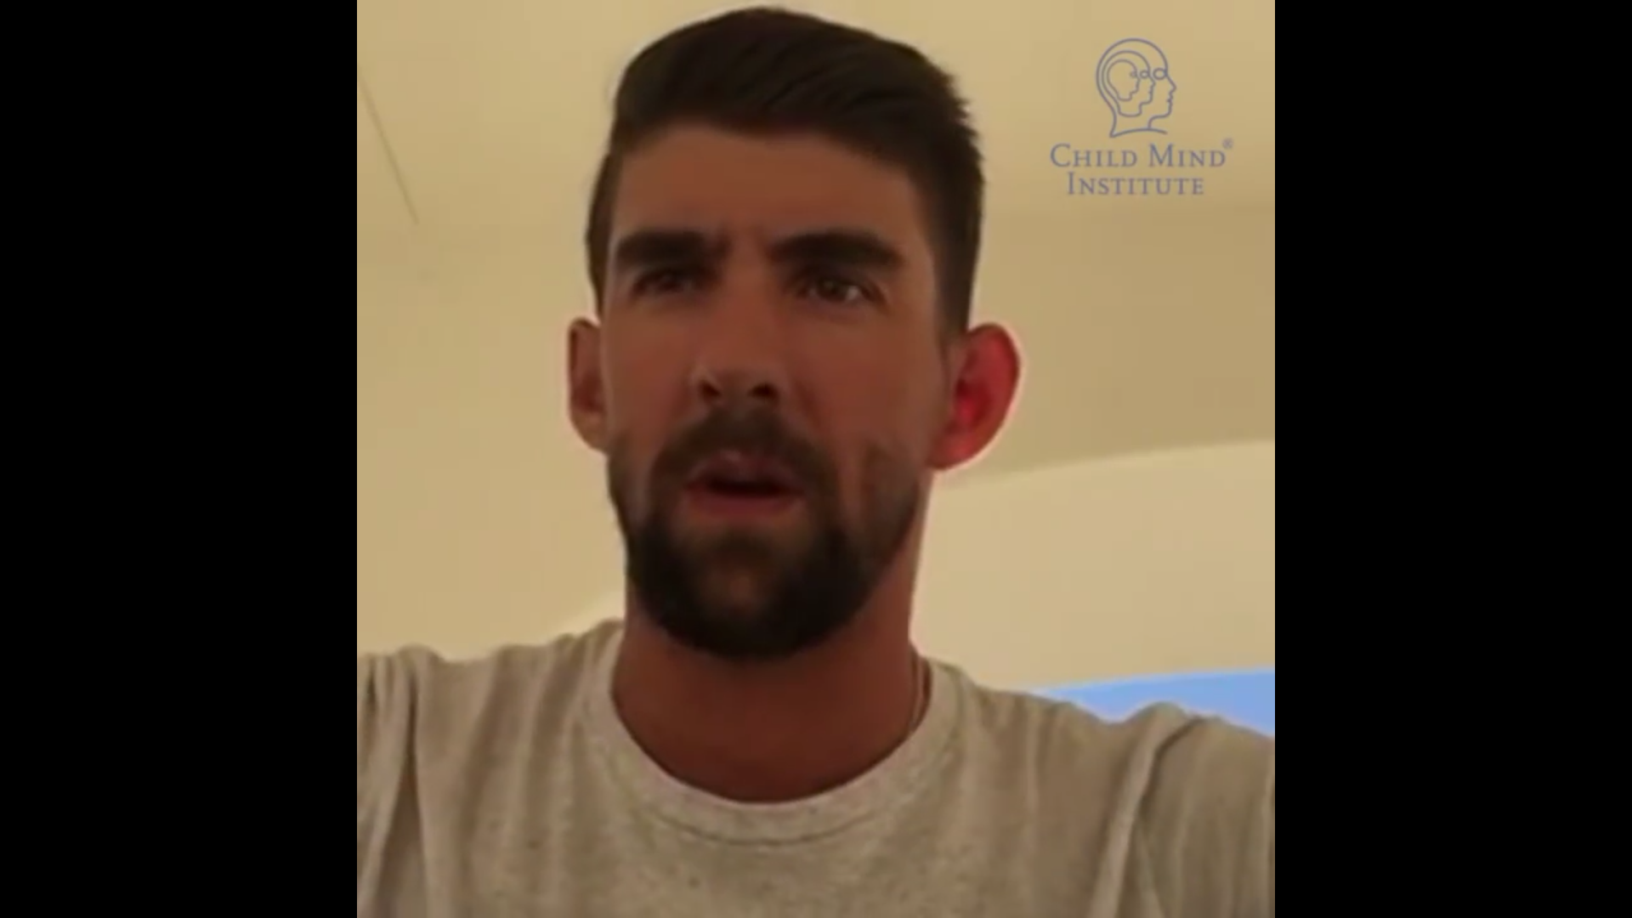
Source: https://speakupforkids.org

Slide 14
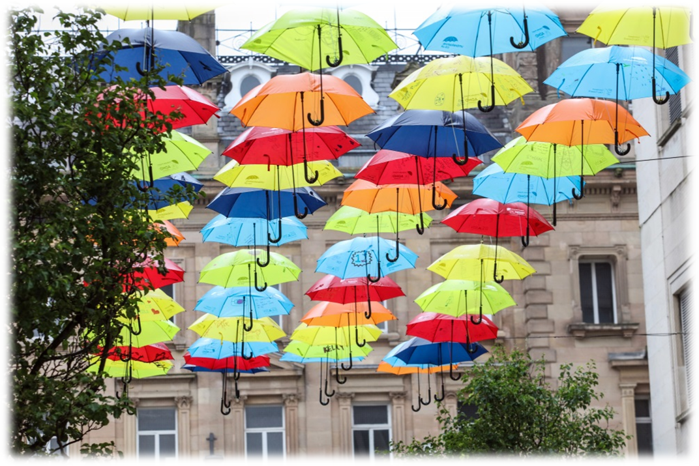
Support us to help people to understand the wonderful qualities of people with ADHD and ASC.
Liverpool and Manchester 2018

