Slide 1

NEURODIVERSITY
CELEBRATION WEEK
13TH-17TH MAY 2019
WITH

Slide 2

What is this all about?
Schools - ‘take the pledge’ and celebrate the intelligence, ability and employability of those individuals with:
Dyspraxia
Dyslexia
ADHD
Autism
Tourette’s Syndrome
Dyscalculia
1 in 5 people are neurodiverse!

Slide 3
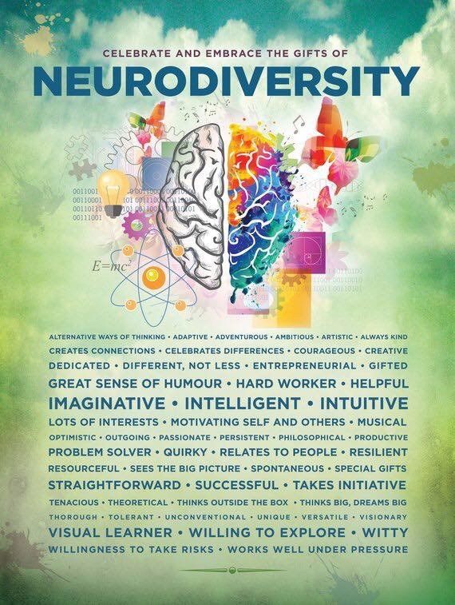
Used with permission posters available from: www.etsy.com/shop/ADHDPosters

Slide 4
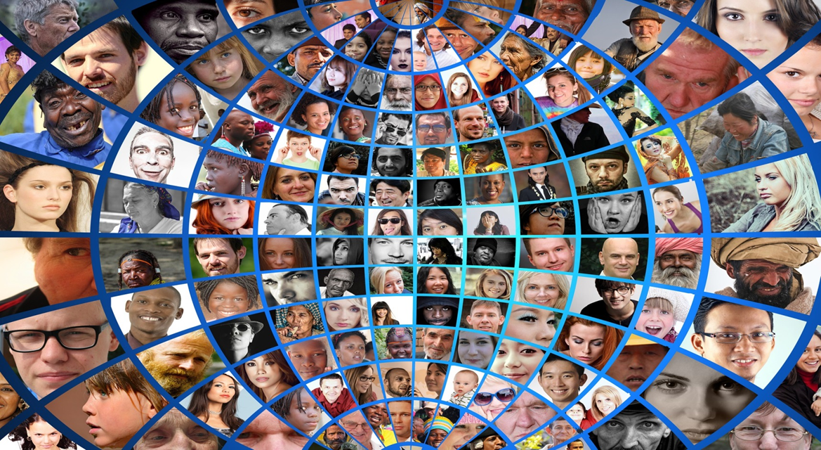
Diversity is inclusion

Slide 5
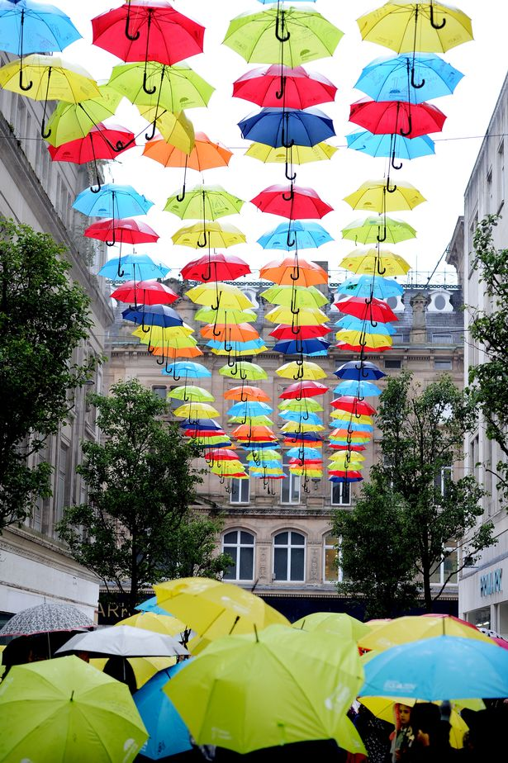
SEND is an ‘umbrella’ term for a range of cognitive impairments affecting 14.6% of young people.
Overall it is estimated that 1 in 5 people are ‘neurodiverse’, including the conditions Dyslexia, Dyspraxia, Dyscalculia, ADHD and Autism. These are ‘umbrella’ terms that describe a range of differences in the way some people’s brains work.
The Umbrella has become a positive uplifting symbol of neurodiversity.

Slide 6
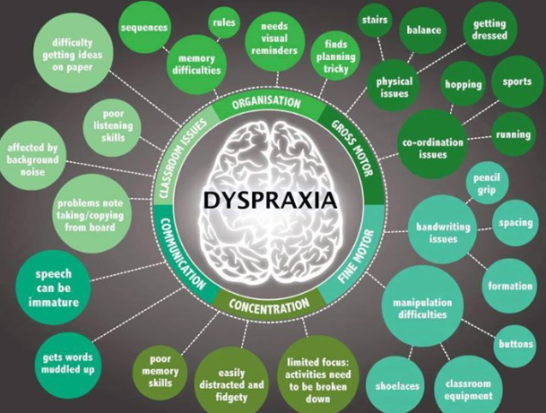
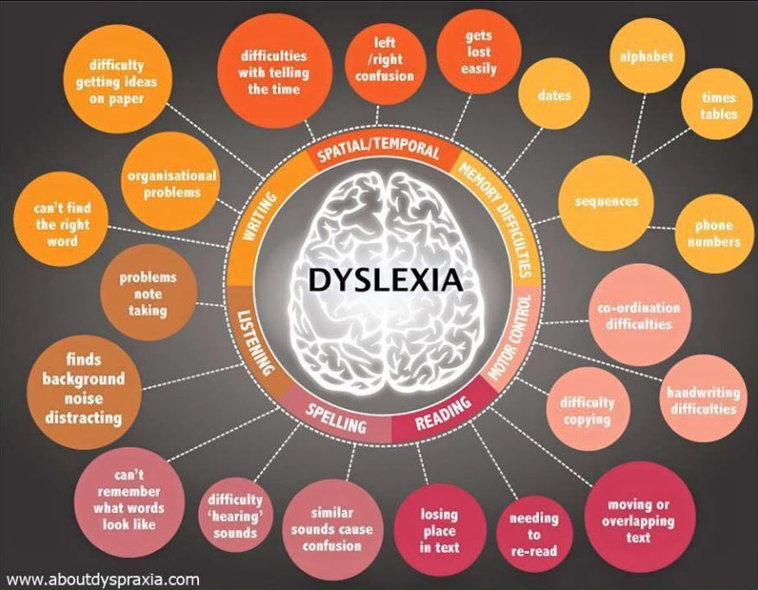
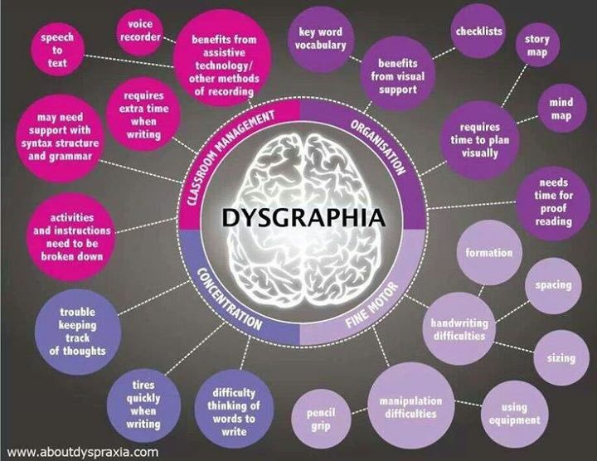
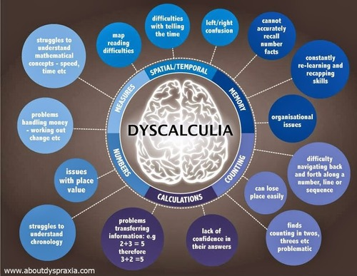

Slide 7

Myths and facts about ADHD
1 in 20 people have ADHD, most are unaware of it. It can be mild, moderate or severe.
ADHD can affect concentration, memory, impulse control, sleep, planning and organising skills .Some parts of the brain develop a bit more slowly – but catch up in late teens.
ADHD is not a behavioural disorder – it is a myth that all those with ADHD behave inappropriately. Also, not everyone with ADHD is hyperactive.
Scientific research tells us that those with ADHD are highly creative and more often academically gifted – though they tend to underachieve in exams because of memory difficulties.
There are a high number of people with ADHD who work in computing, the creative industries, art, music, acting, professional sports – but you will find there are people with ADHD in every profession – including police officers, teachers, engineers… just about every job there is!

Slide 8
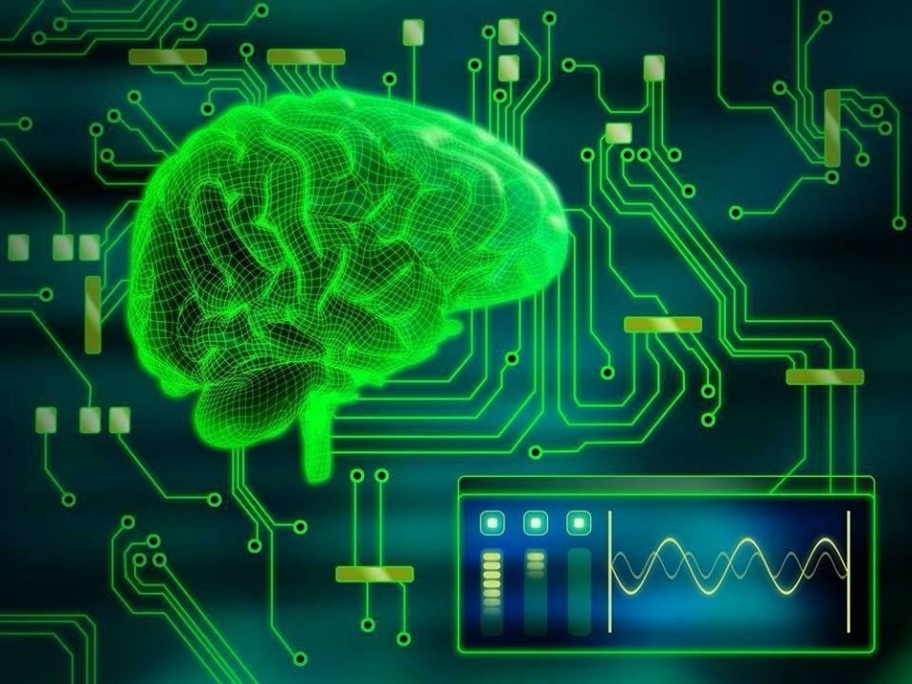
Myths and facts about Autism
Autism affects approximately 1 in every 100 people.
Autism can impact on people in many different ways.
Some people experience difficulty with social and communication skills.
Many people with autism are incredibly gifted and academically very successful as they can have excellent memory and analytical skills.
There are many very successful people with autism. You will find people with autism in every career occupation – and every family

Slide 9
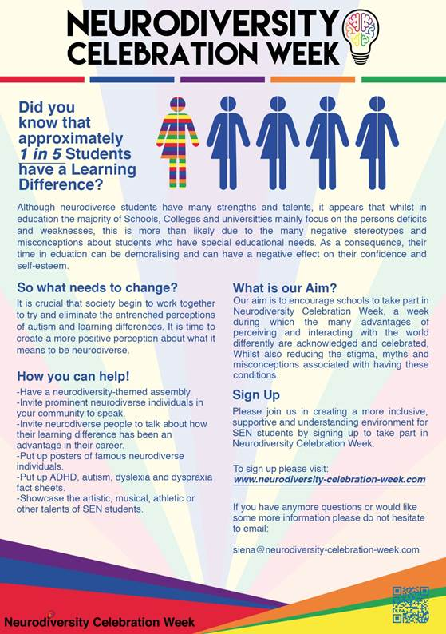
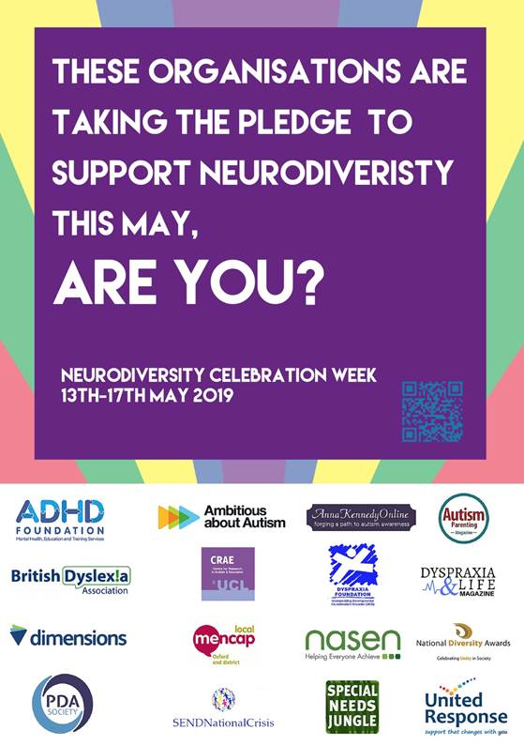

Slide 10
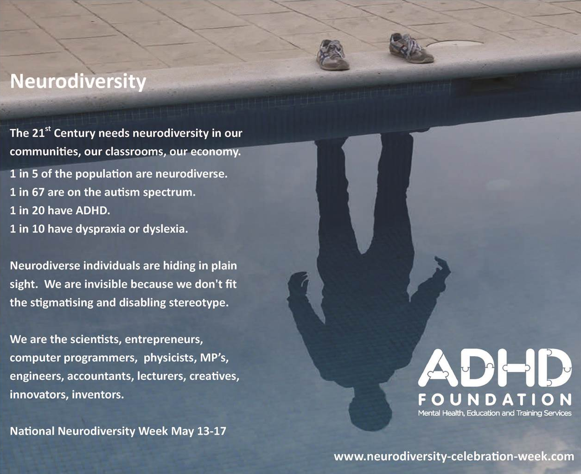
Shining a light on successful neurodiverse role models.
Making the invisible visible.

Slide 11
Schools take The Pledge
To celebrate neurodiversity
To enable young people with SEND to see themselves as intelligent achievers
To challenge stigma, stereotype, discrimination and poverty of aspiration
Counter a deficit model of intelligence, ability and employability
Understand that neurodiversity is Inclusion
Focus on strengths, talents and abilities
Sign on line and take the pledge for your school.
Stage a school assembly to celebrate and educate about neurodiversity.
www.neurodiversity-celebration-week.com

Slide 12

Umbrella Project 2019
Individual schools can now participate in this year’s
Umbrella Project by having their own umbrella display in their schools.
For more information on how to get involved, contact Paula Stock at:
Paula.Stock@adhdfoundation.org.uk

Slide 13
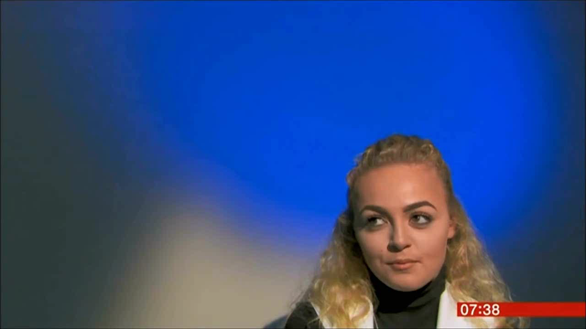
Four young people talk about living with ADHD.
Where do you think they are now?

Slide 14

Celebrities who are Neurodiverse
Zayn
Malik
ADHD

Slide 15
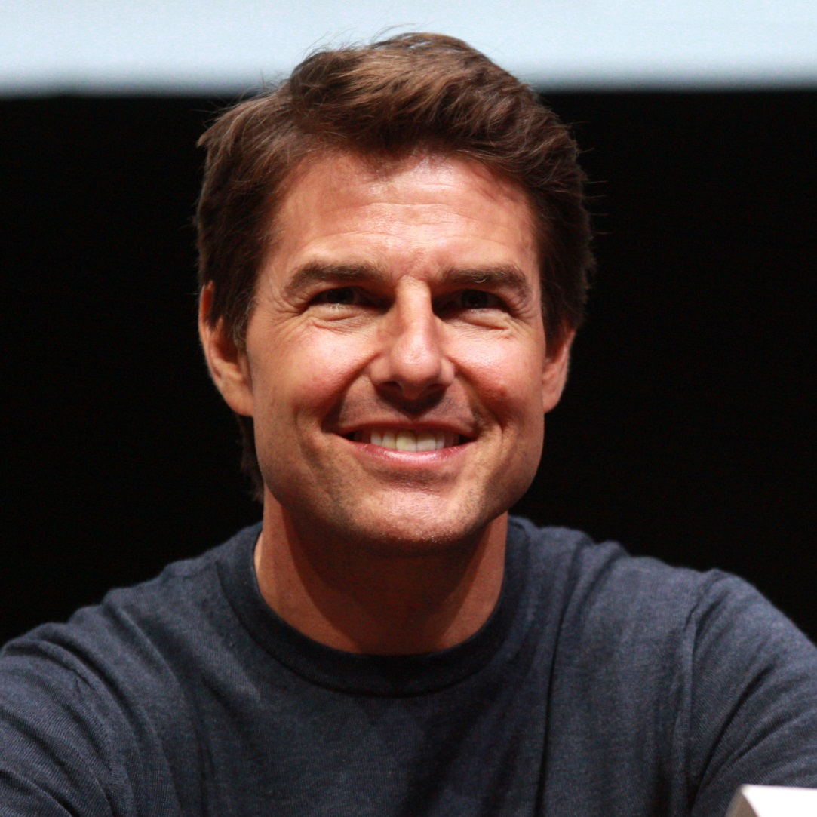
Celebrities who are Neurodiverse
Tom
Cruise
Dyslexia

Slide 16

Celebrities who are Neurodiverse
Robbie Williams
ADHD

Slide 17
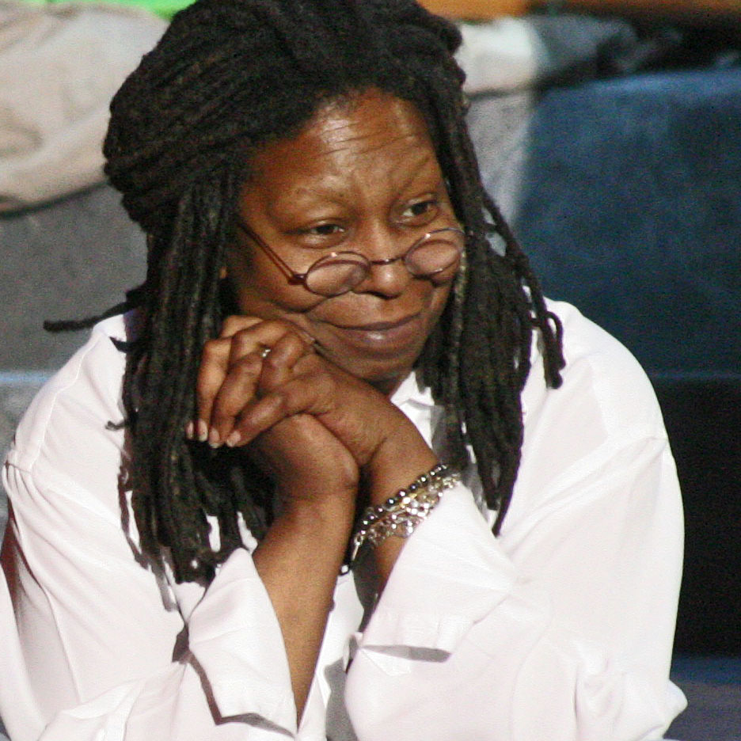
Celebrities who are Neurodiverse
Whoopi Goldberg
Dyslexia

Slide 18
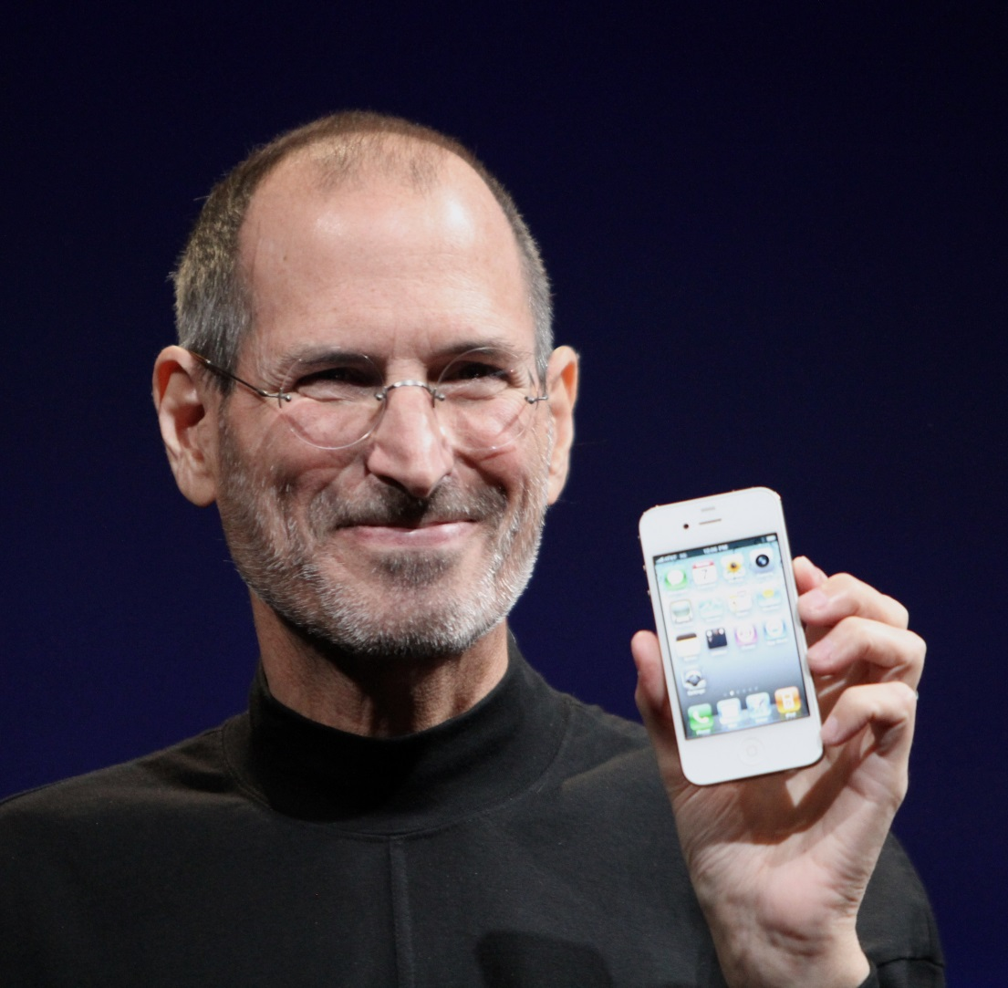
Celebrities who are Neurodiverse
Steve
Jobs
Autism

Slide 19
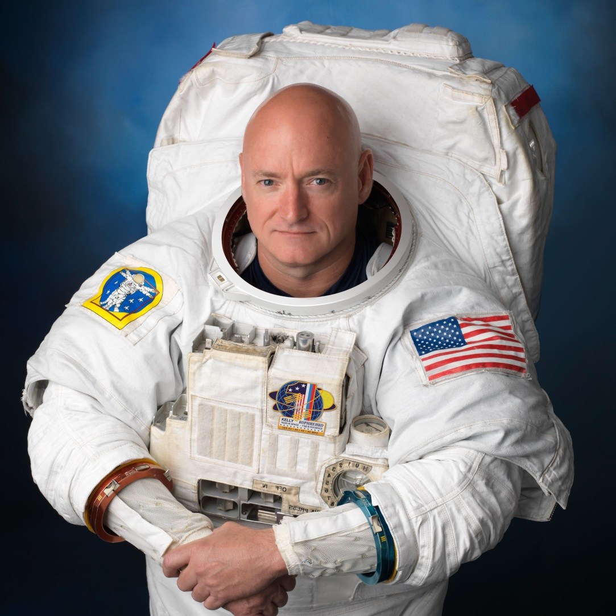
Celebrities who are Neurodiverse
Scott
Kelly
ADHD

Slide 20
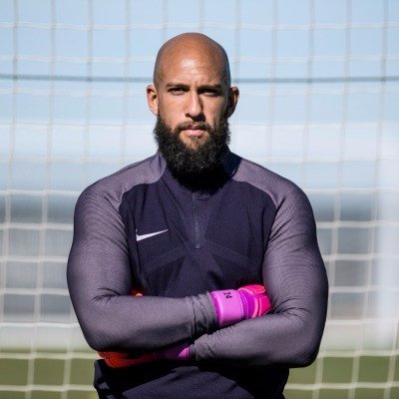
Celebrities who are Neurodiverse
Tim Howard
Tourette’s Syndrome

Slide 21
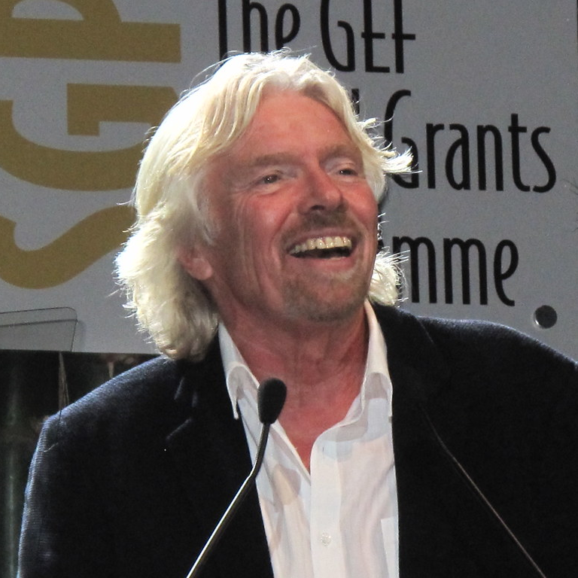
Celebrities who are Neurodiverse
Sir Richard Branson
Dyslexia

Slide 22

Celebrities who are Neurodiverse
Rory Bremner
ADHD

Slide 23

Celebrities who are Neurodiverse
Daniel Radcliffe
Dyspraxia

Slide 24
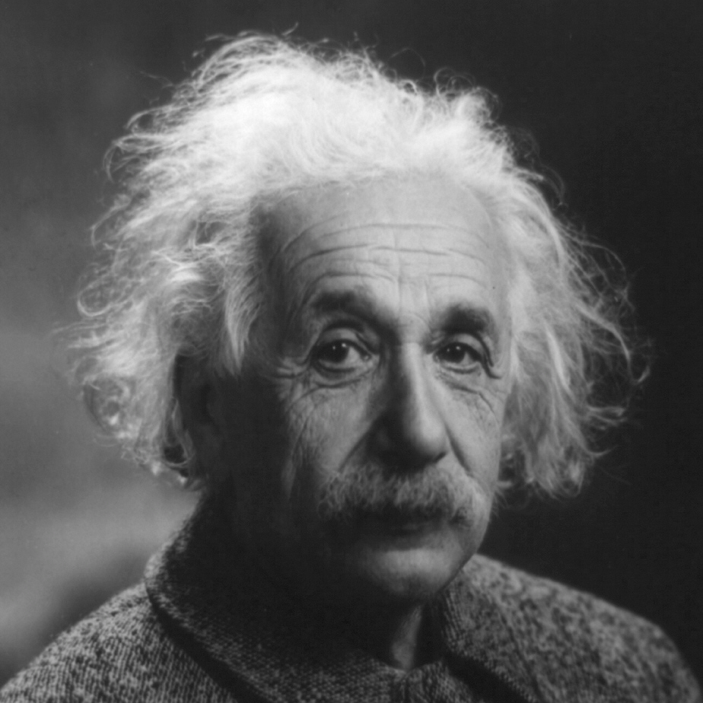
Celebrities who are Neurodiverse
Albert Einstein
Autism and Dyslexia

Slide 25
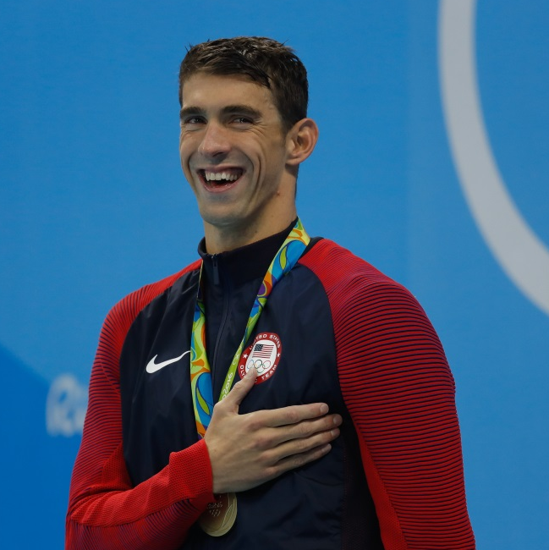
Celebrities who are Neurodiverse
Michael Phelps
ADHD

Slide 26

Celebrities who are Neurodiverse
Ed Sheeran
Speech and Language Difficulty and
Stutter

Slide 27
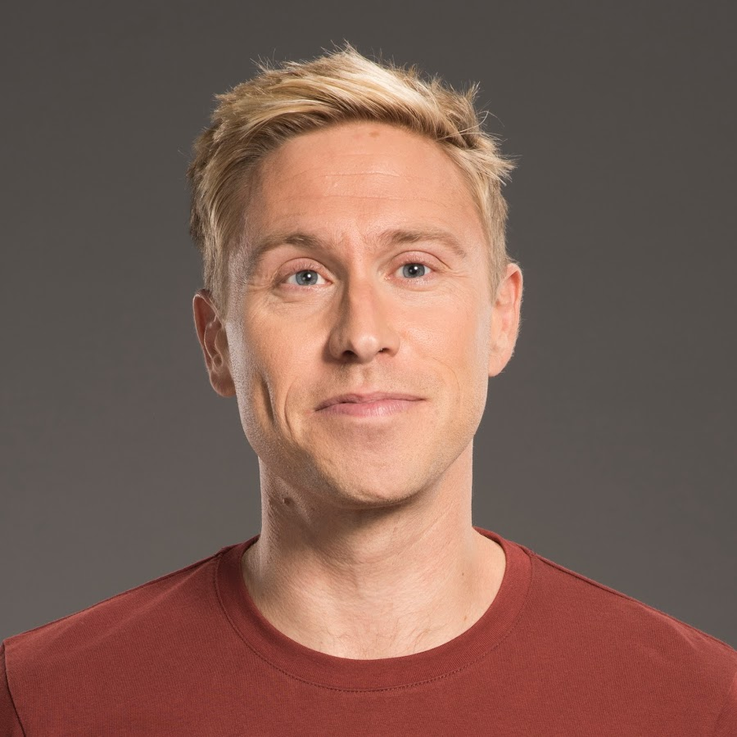
Celebrities who are Neurodiverse
Russell Howard
ADHD

Slide 28
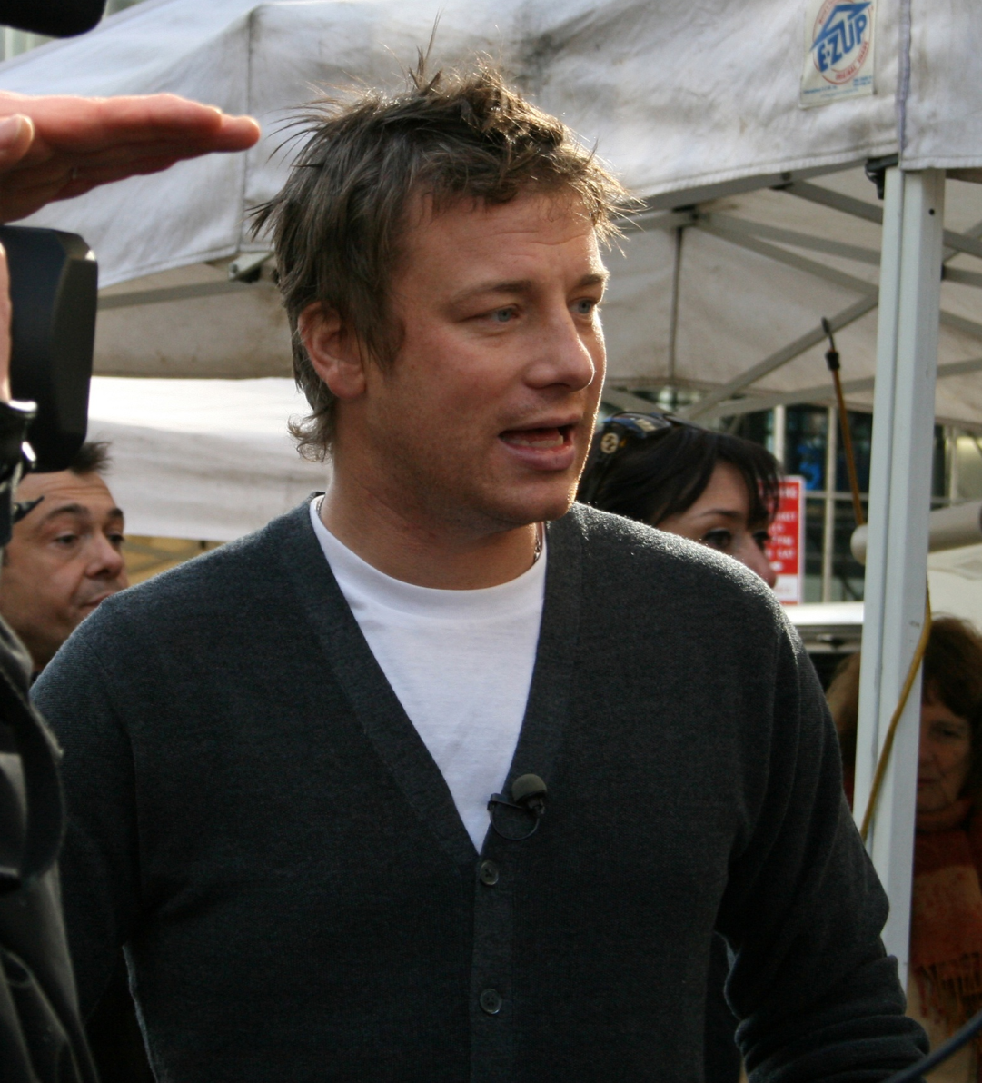
Celebrities who are Neurodiverse
Jamie Oliver
ADHD and Dyslexia

Slide 29
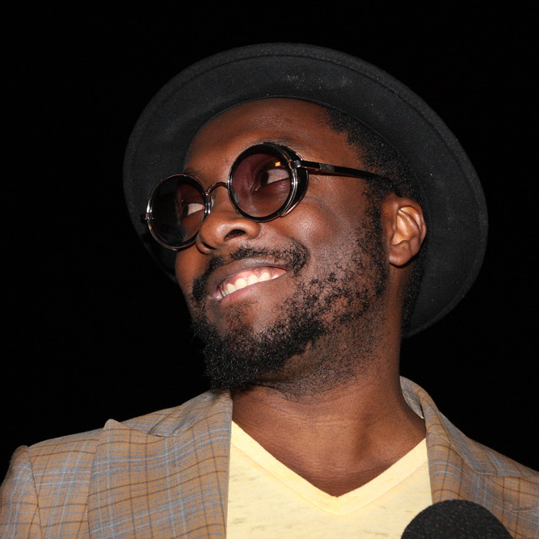
Celebrities who are Neurodiverse
Will.I.Am
ADHD

Slide 30

Celebrities who are Neurodiverse
Steven Spielberg
Dyslexia

Slide 31

Celebrities who are Neurodiverse
Ryan Gosling
ADHD

Slide 32
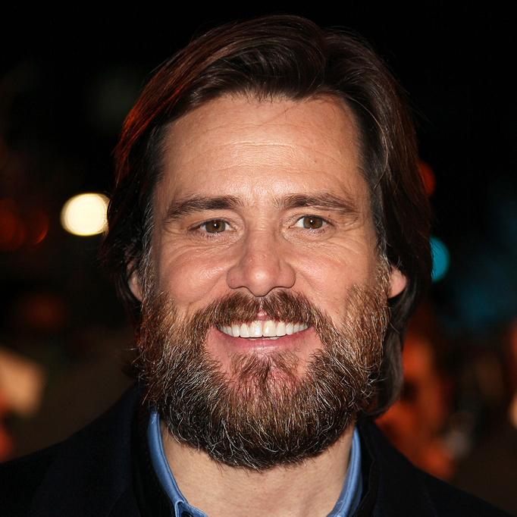
Celebrities who are Neurodiverse
Jim
Carrey
ADHD

Slide 33
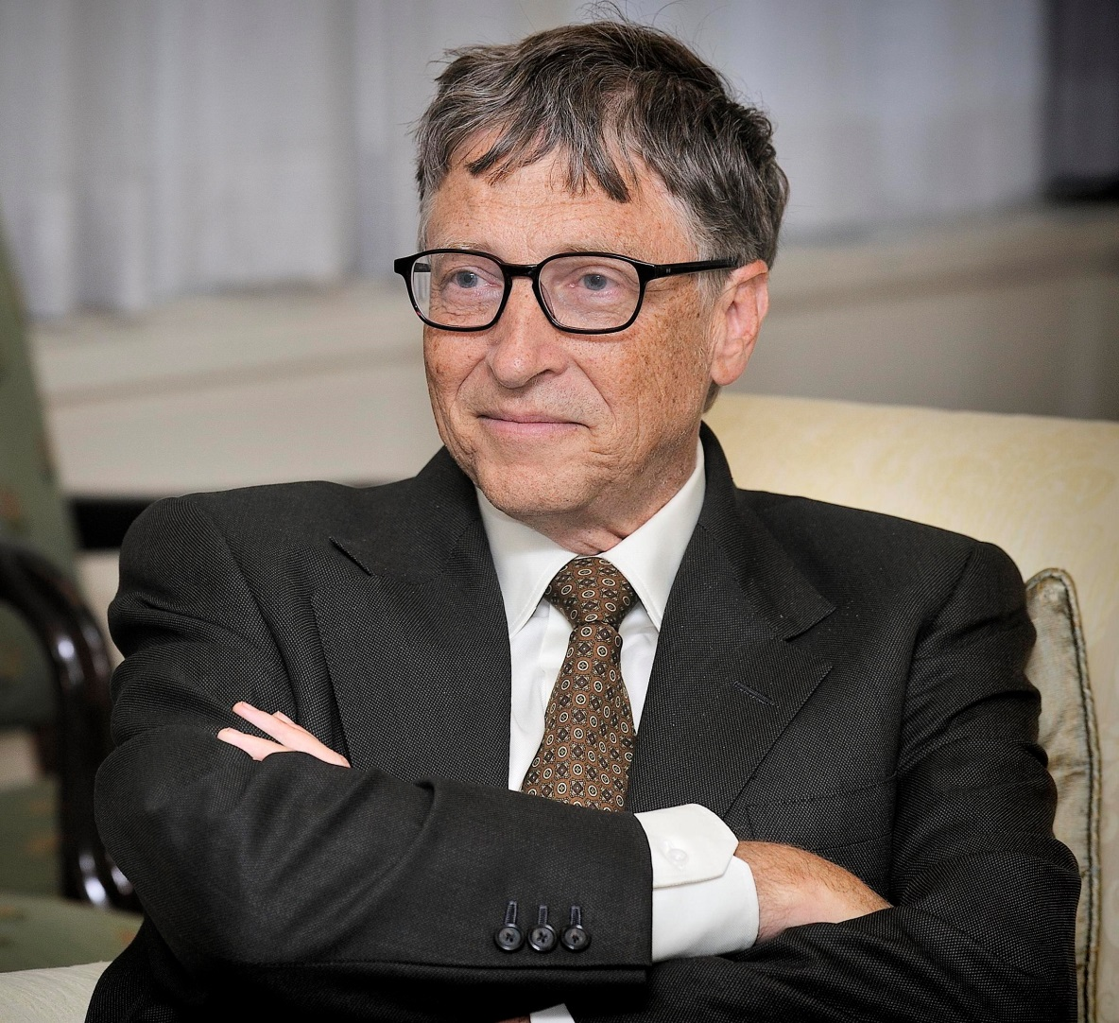

Celebrities who are Neurodiverse
Bill
Gates
Dyscalculia

Slide 34
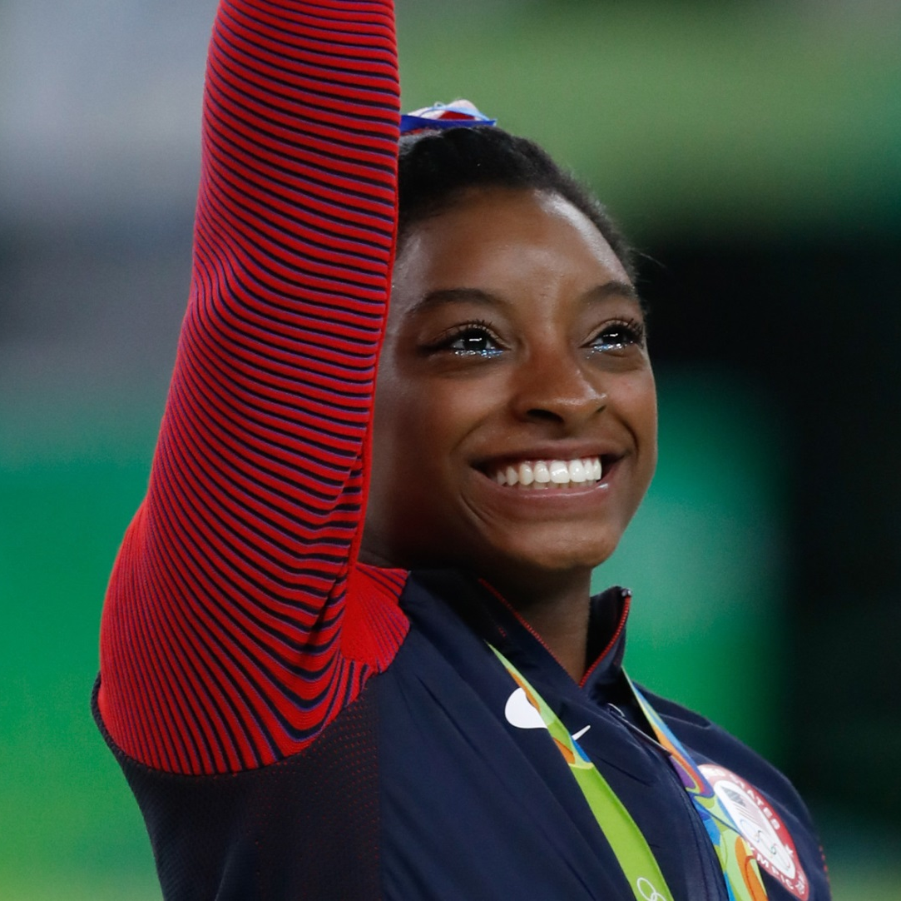
Celebrities who are Neurodiverse
Simone Biles
ADHD

Slide 35

Celebrities who are Neurodiverse
Dan Aykroyd
Tourette’s Syndrome

Slide 36

Celebrities who are Neurodiverse
Justin Timberlake
ADHD

Slide 37
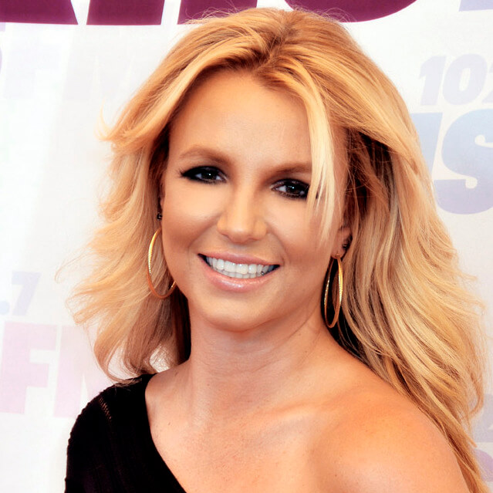
Celebrities who are Neurodiverse
Britney Spears
ADHD and Dyslexia

Slide 38

Celebrities who are Neurodiverse
Heston Blumenthal
ADHD

Slide 39
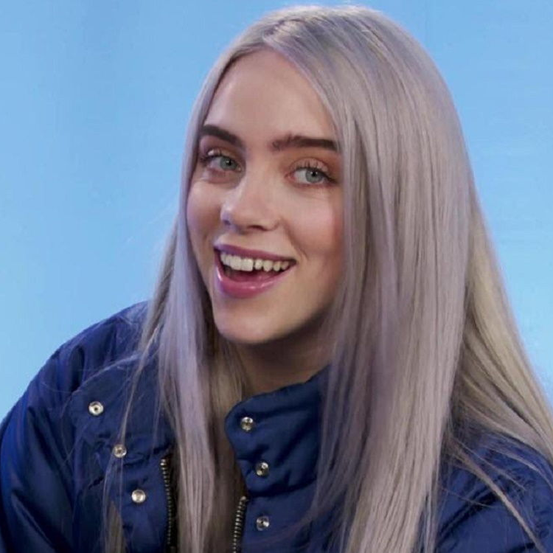
Celebrities who are Neurodiverse
Billie
Eilish
Tourette’s Syndrome

Slide 40
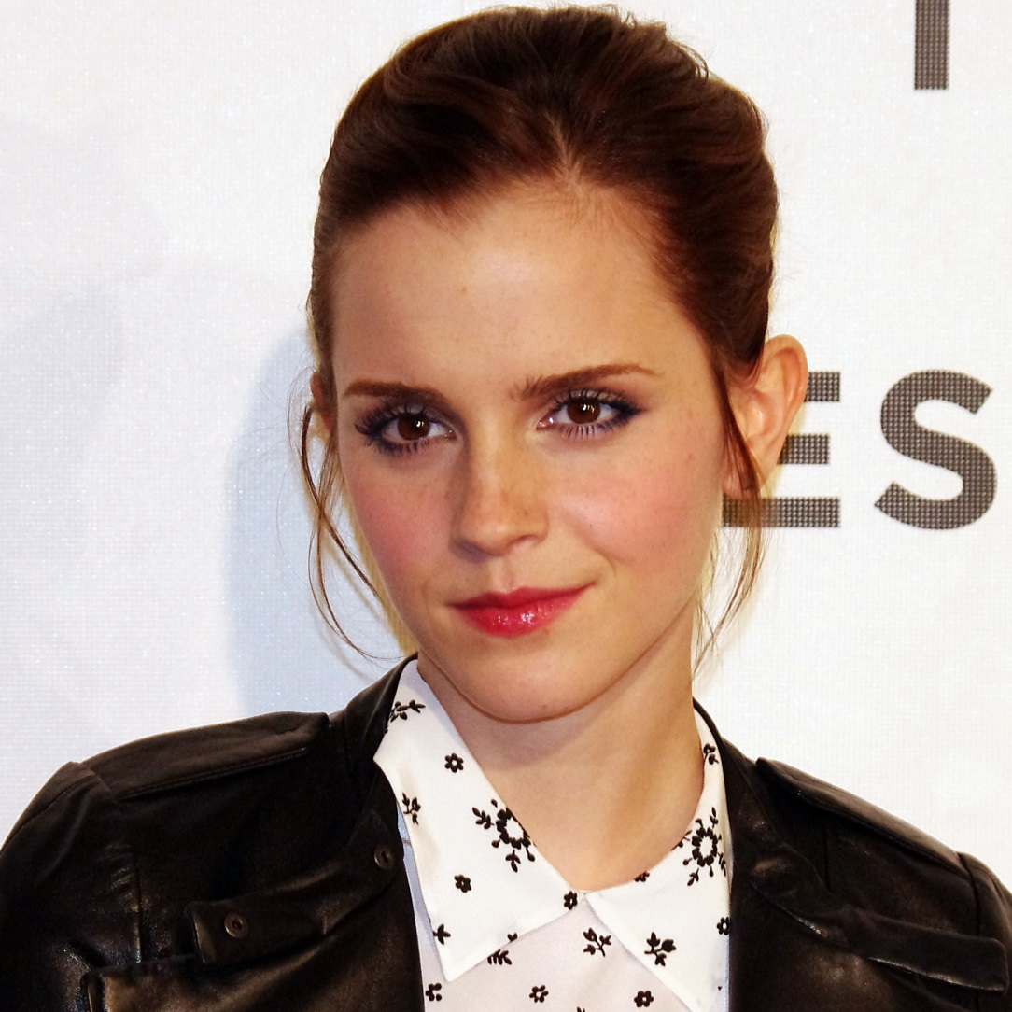
Celebrities who are Neurodiverse
Emma Watson
ADHD

Slide 41

Celebrities who are Neurodiverse
Channing Tatum
Dyslexia and ADHD

Slide 42

Celebrities who are Neurodiverse
Adam Levine
ADHD

Slide 43
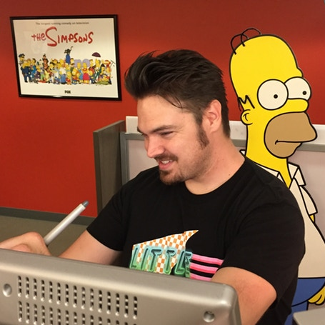
Celebrities who are Neurodiverse
Chance Raspberry
Tourette’s Syndrome

Slide 44

Celebrities who are Neurodiverse
Will
Smith
ADHD

Slide 45

Celebrities who are Neurodiverse
Bart Simpson
ADHD

Slide 46
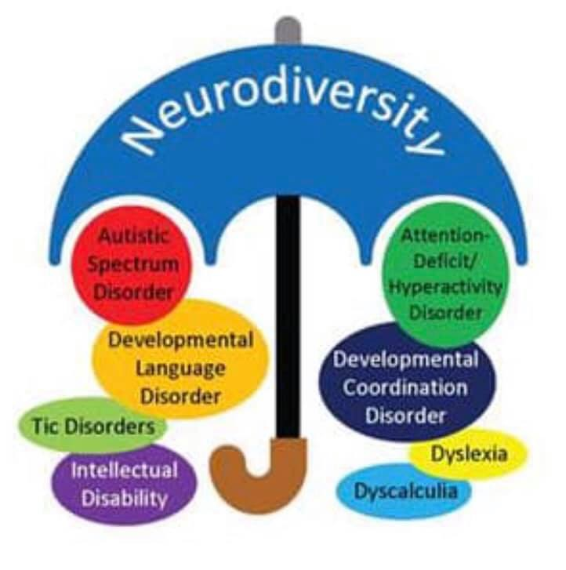
What next for your school?
How can you celebrate the unique intelligence, ability and talents of neurodiverse pupils with:
Dyslexia
Dyspraxia
ADHD
Dyscalculia
Autism
Dysgraphia

