Slide 2
What is the Umbrella Project?
It is an art display which celebrates the gifts and talents of those who are neurodiverse, and part of a wider education project to celebrate neurodiversity, raise awareness and challenge stigma and discrimination.
The umbrellas celebrate the unique gifts of every child. Each umbrella is signed by a child stating “My Super Power is...”

Slide 3
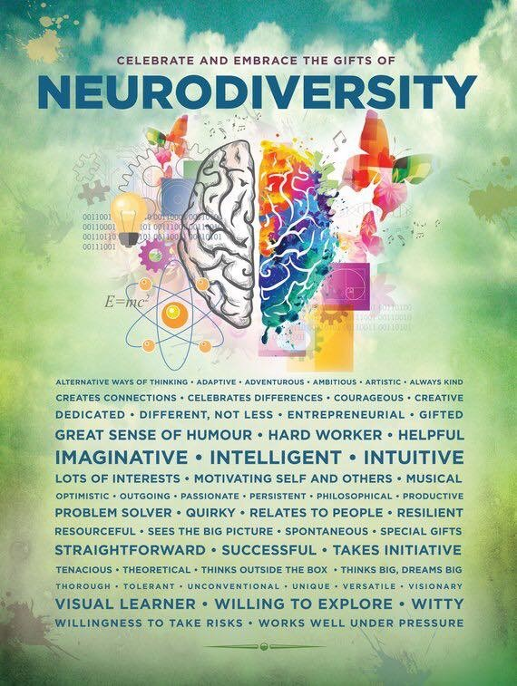
What is Neurodiversity?
Neurodiversity is about celebrating ability.
Every achievement, no matter how small, is one step closer to becoming who you really are.
It’s not about comparing yourself to others – it’s about being proud of what makes you unique!
Used with permission. Posters are available from: www.etsy.com/shop/ADHDPosters

Slide 4
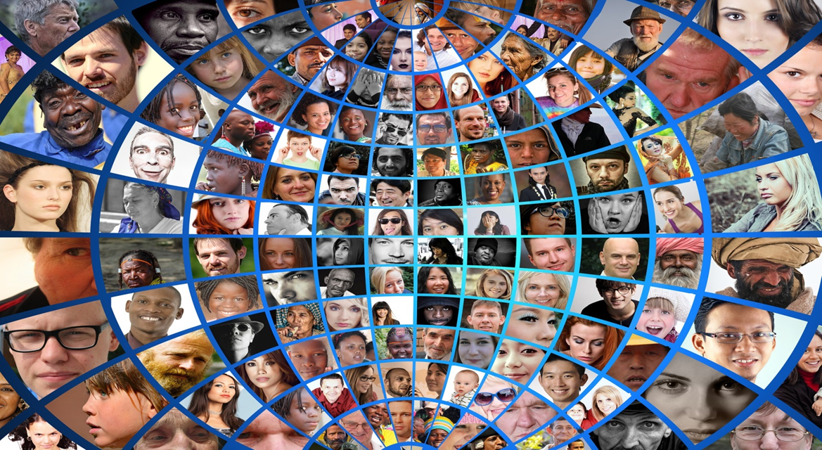
Diversity is inclusion

Slide 5
Some disabilities look like this:
Some look like this:
We ‘disable’ people when we only talk about what they ‘can not do’. We should talk more about what they ‘CAN DO’.
A positive attitude, kindness, honesty, citizenship, ambition, generosity, compassion and empathy are not measured in exams – but those abilities and qualities will determine your success and happiness… because ‘I am’ and
‘I CAN’ are more important than ‘IQ’.
Notes:
Some disabilities look like this: Some look like this.

Slide 6
SEND is an ‘umbrella’ term for a range of cognitive impairments affecting 14.6% of young people. 1 in 5 people are neurodiverse, including conditions like Dyslexia, ADHD, and Autism. These ‘umbrella’ terms describe a range of differences in how people’s brains work. The umbrella has become a positive uplifting symbol of neurodiversity.
The Umbrella is a symbol of Neurodiversity

Slide 7
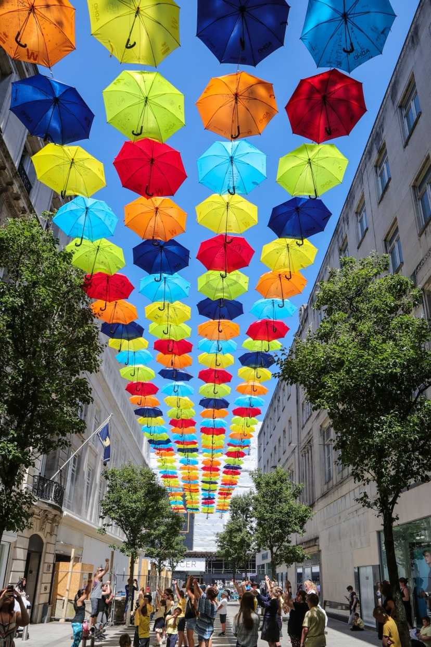
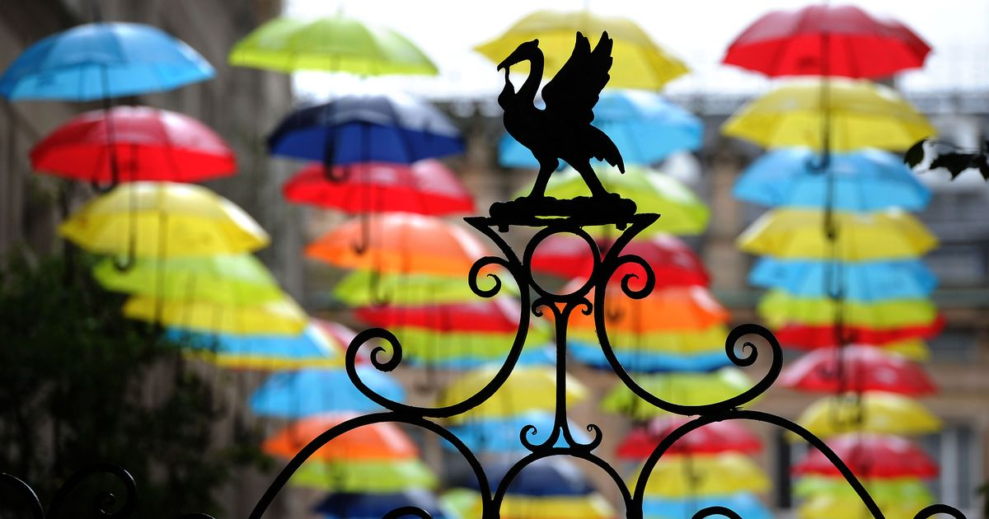
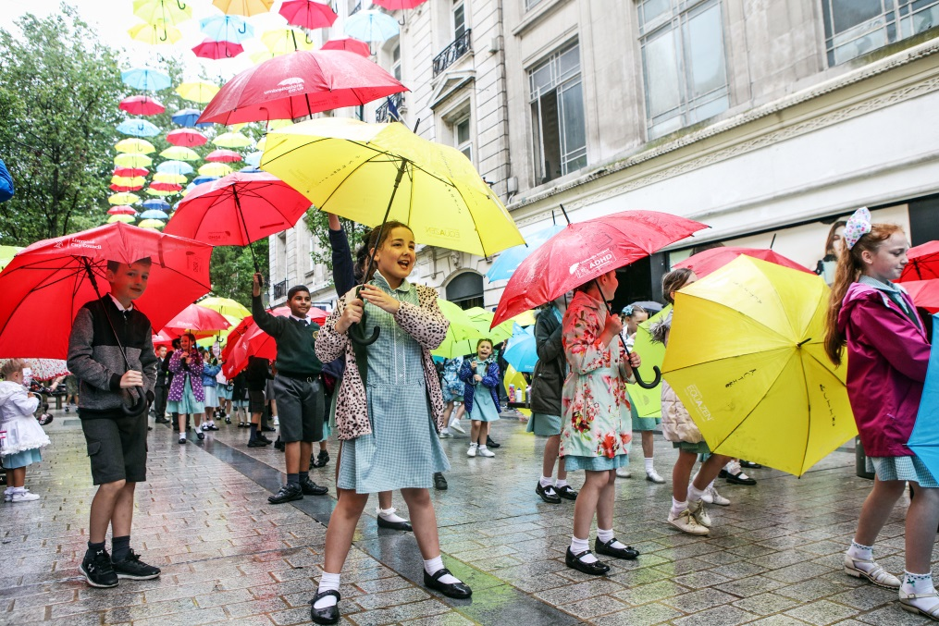
Celebrate your differences with the Umbrella Project

Slide 8
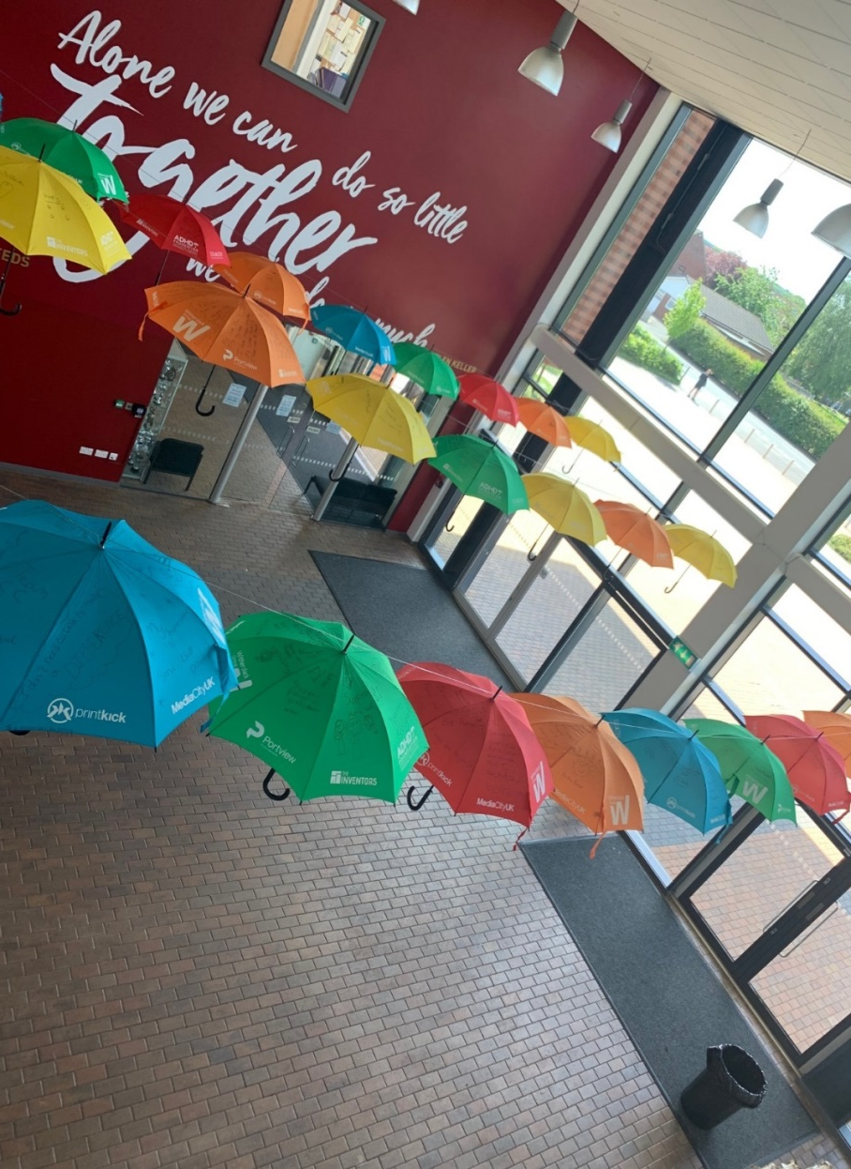
Students - take The Pledge
We are calling on every neurodiverse student to speak openly about what it is like to have a neurodiverse condition, for example:
ADHD
Dyslexia
Autism
Tourette’s Syndrome
Dyspraxia
Dyslexia
We ask you to talk about your ability, your talents, and your potential.
Tell the world you will not be defined by what you can ‘not’ do, but what you CAN DO. Make your neurodiversity a celebration!

Slide 9
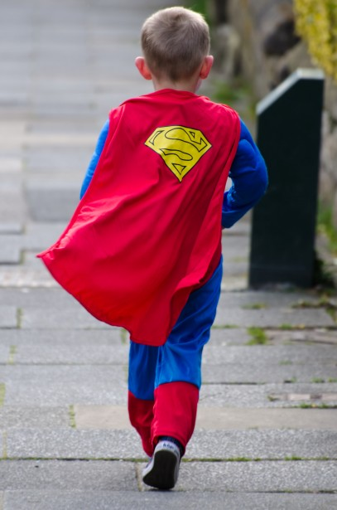
Celebrities who are Neurodiverse
Neurodiversity can be a superpower if you learn how to use it.
There are lots of successful people who are neurodiverse too.
Here are some of those people…

Slide 10
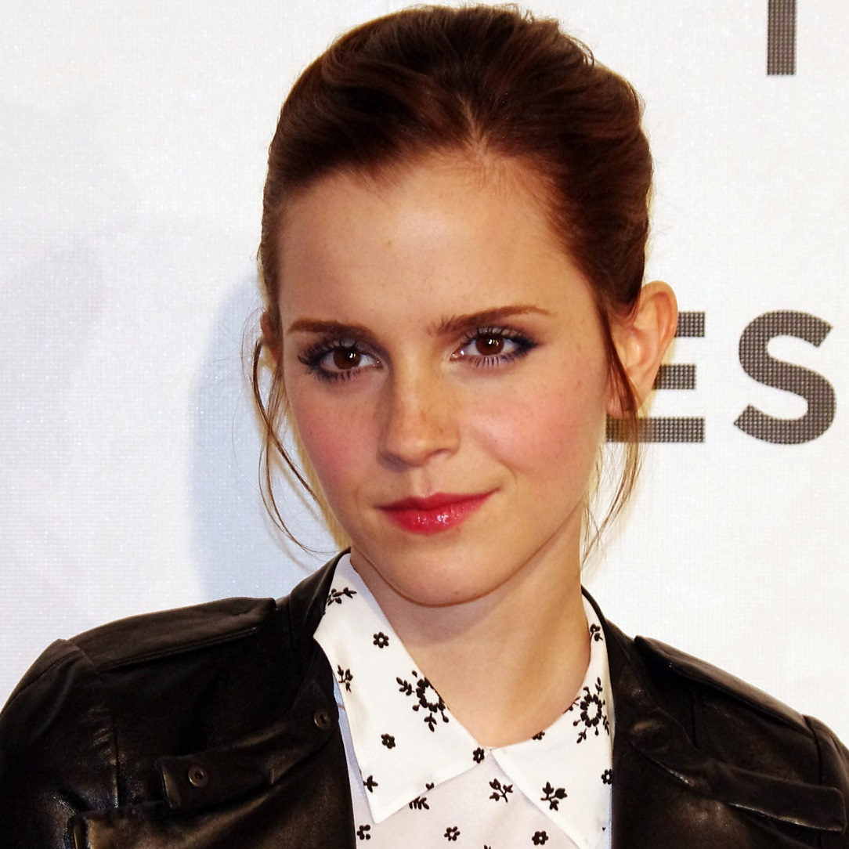
Celebrities who are Neurodiverse
Emma Watson
ADHD

Slide 11
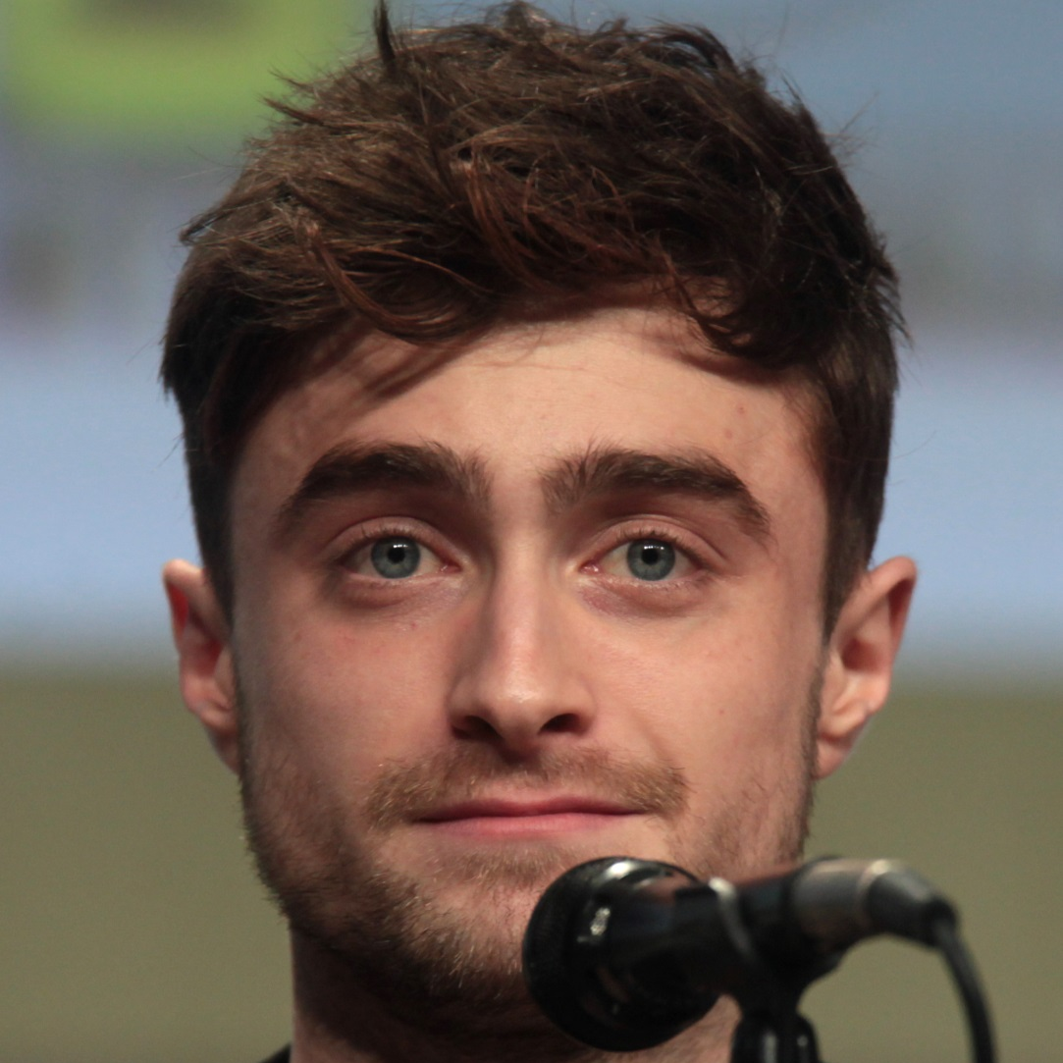
Celebrities who are Neurodiverse
Daniel Radcliffe
Dyspraxia

Slide 12
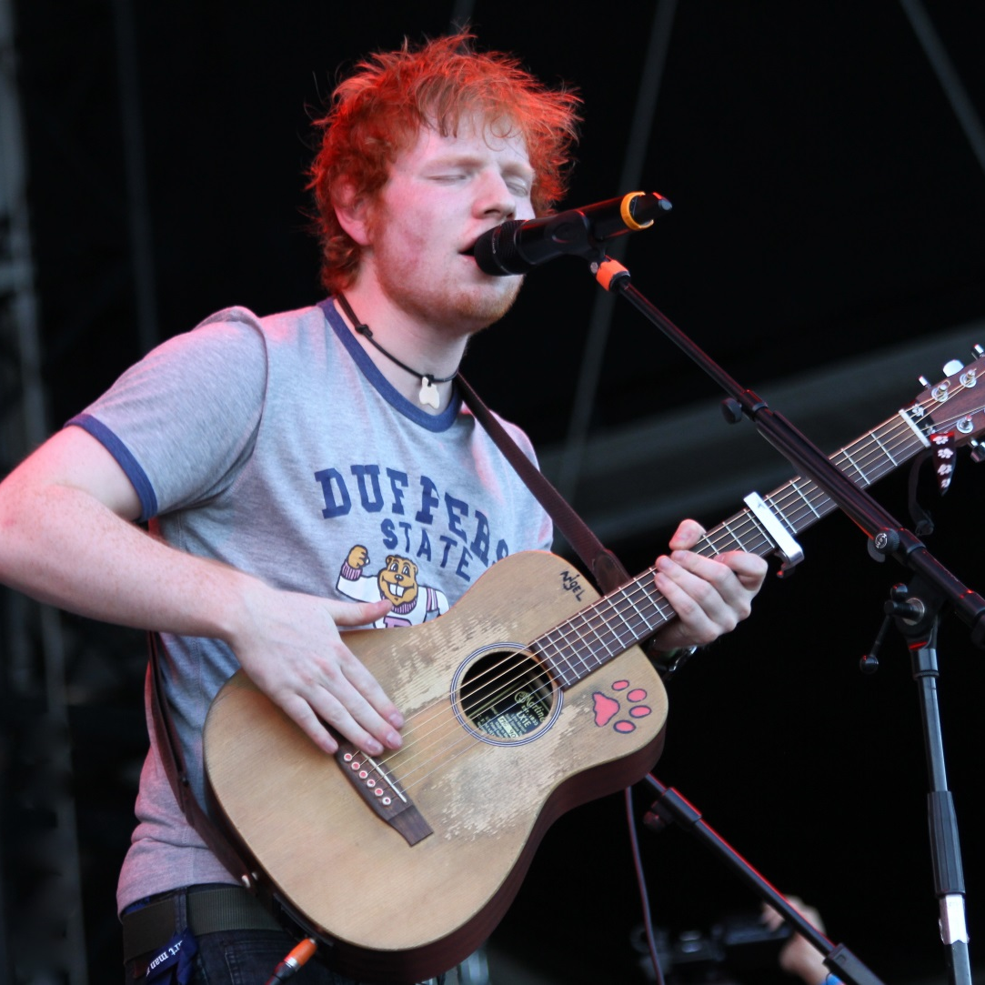
Celebrities who are Neurodiverse
Ed Sheeran
Speech and Language Difficulty and Stutter

Slide 13
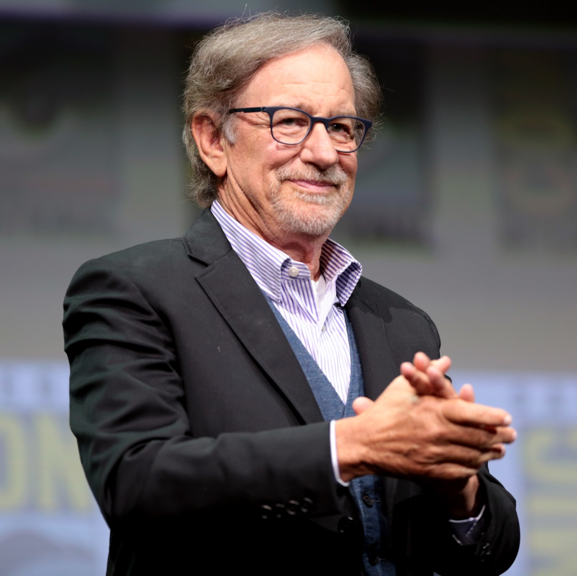
Celebrities who are Neurodiverse
Steven Spielberg
Dyslexia

Slide 14
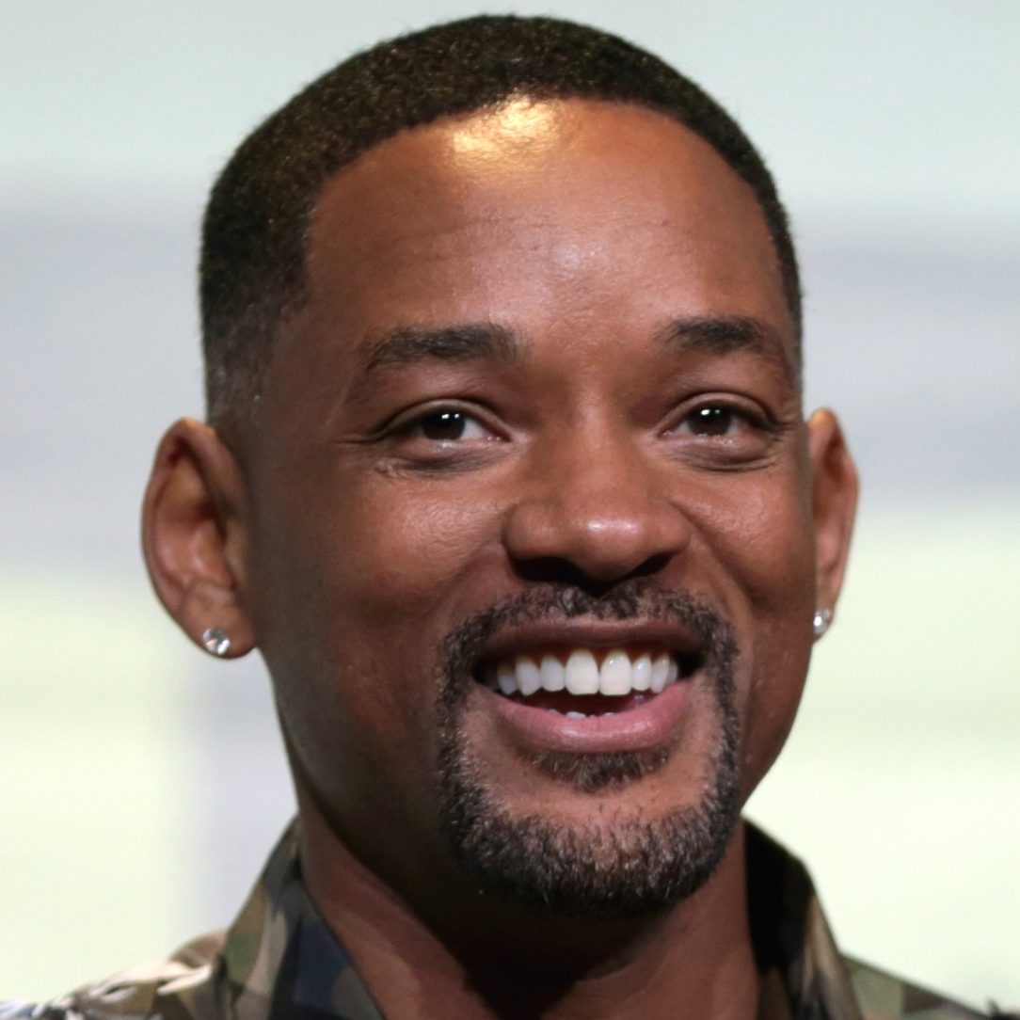
Celebrities who are Neurodiverse
Will Smith
ADHD

Slide 15
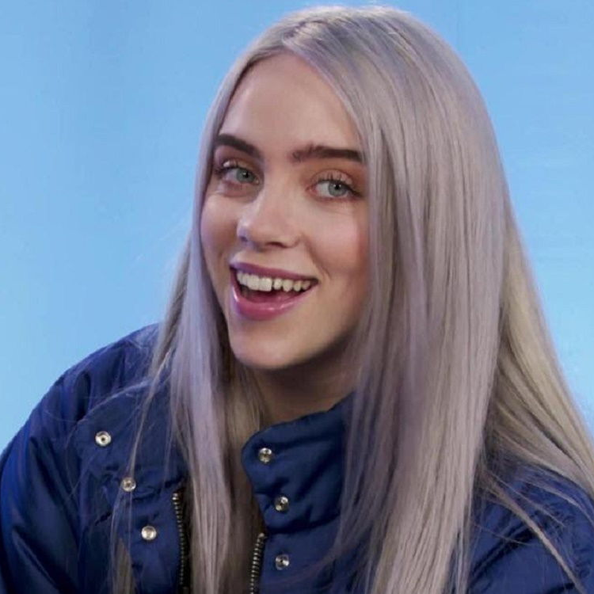
Celebrities who are Neurodiverse
Billie Eilish
Tourette’s Syndrome

Slide 16
Celebrities who are Neurodiverse
Zayn
Malik
ADHD

Slide 17
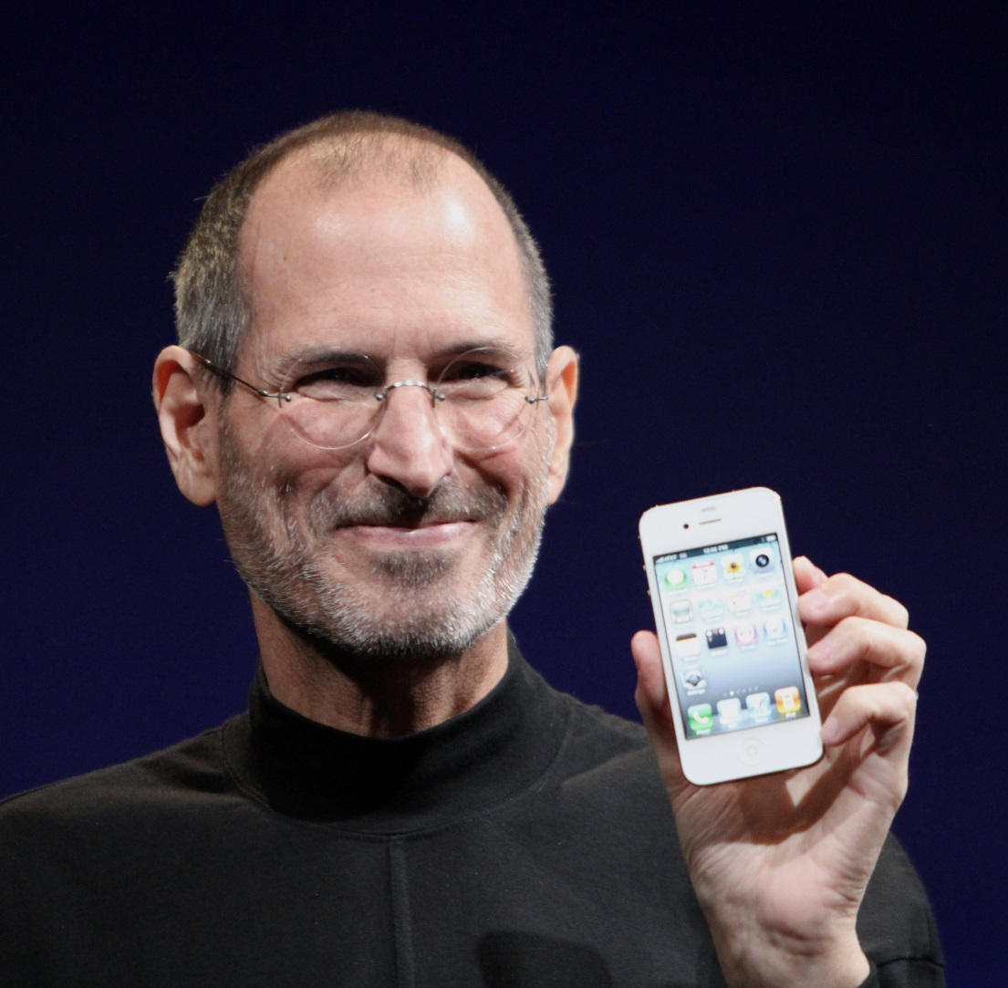
Celebrities who are Neurodiverse
Steve Jobs
Autism

Slide 18
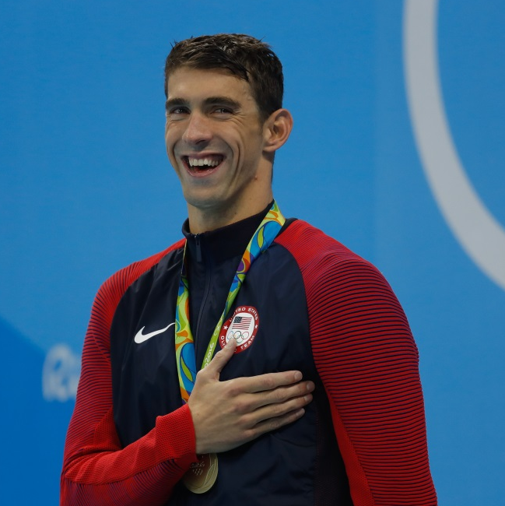
Celebrities who are Neurodiverse
Michael Phelps
ADHD

Slide 19
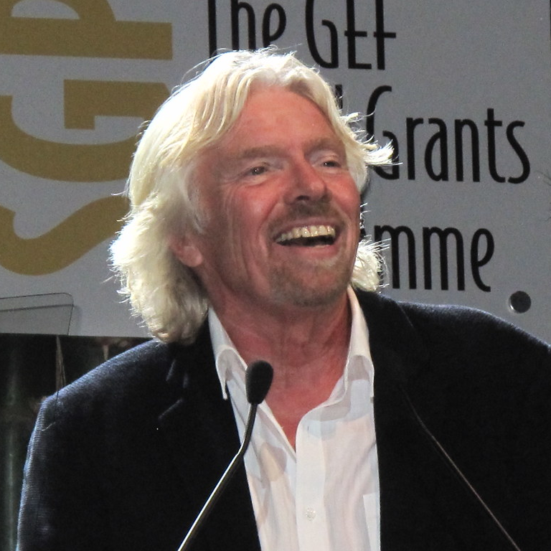
Celebrities who are Neurodiverse
Sir Richard Branson
Dyslexia

Slide 20
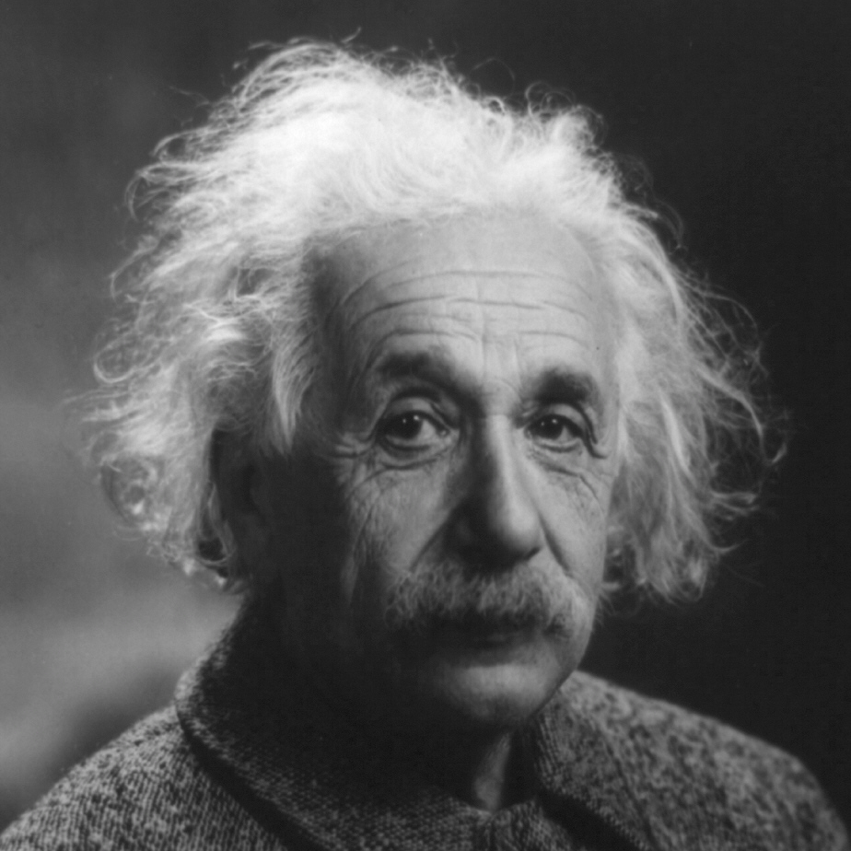
Celebrities who are Neurodiverse
Albert Einstein
Autism and Dyslexia

Slide 21
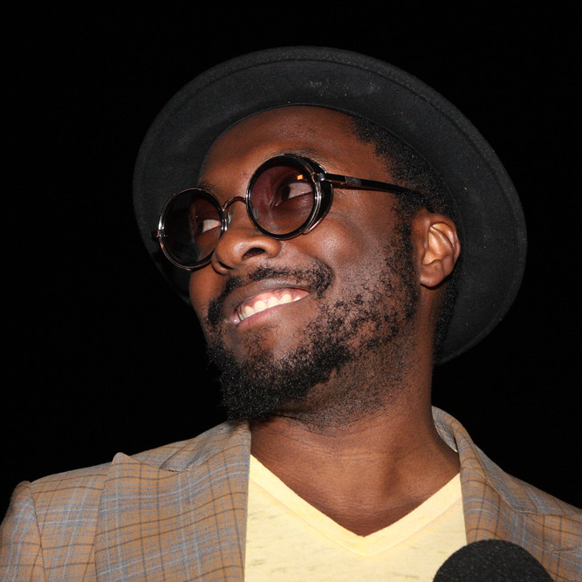
Celebrities who are Neurodiverse
Will.I.Am
ADHD

Slide 22
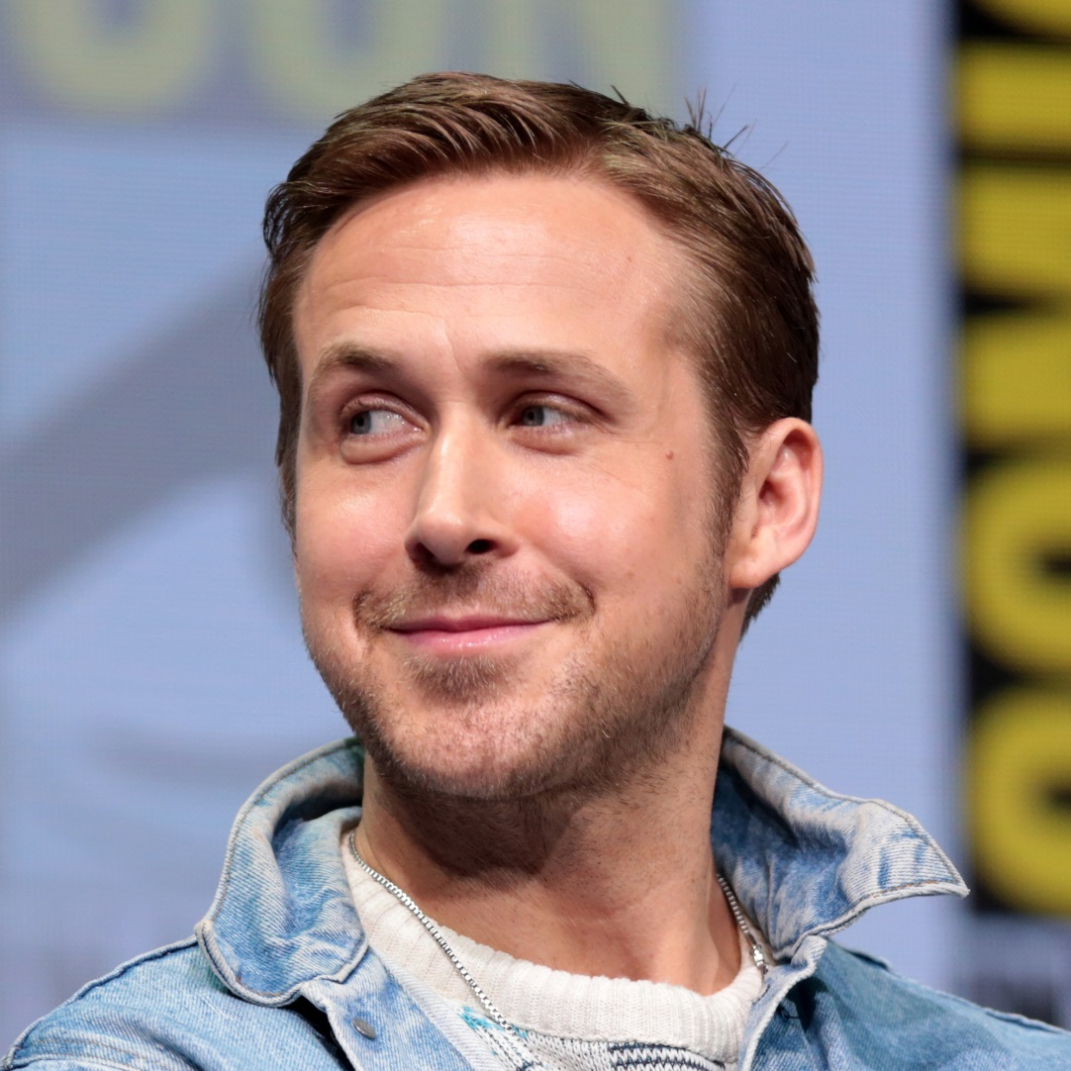
Celebrities who are Neurodiverse
Ryan Gosling
ADHD

Slide 23
Celebrities who are Neurodiverse
Tom Cruise
Dyslexia

Slide 24
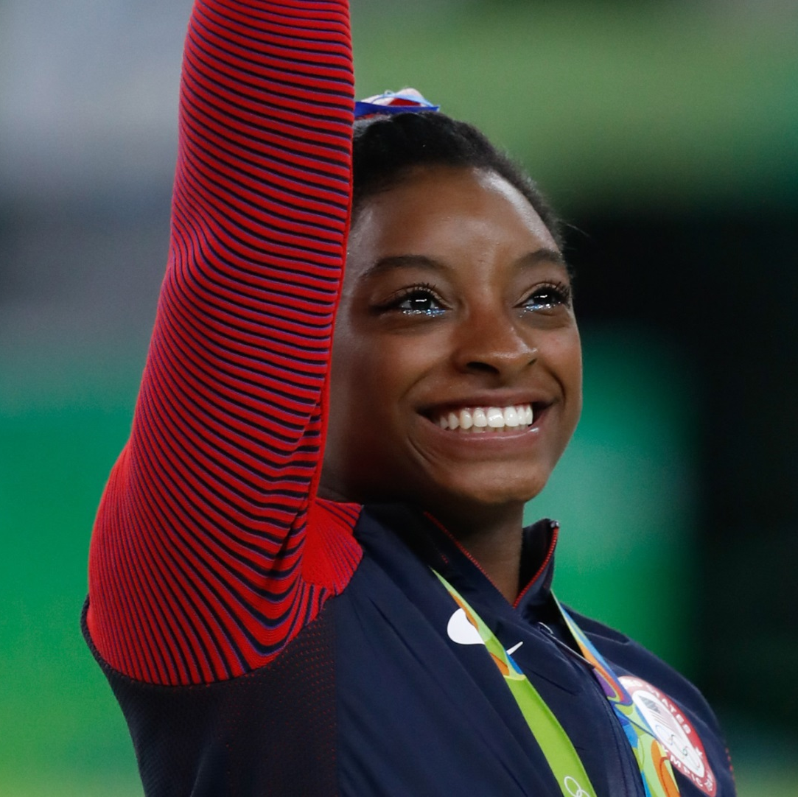
Celebrities who are Neurodiverse
Simone Biles
ADHD

Slide 25
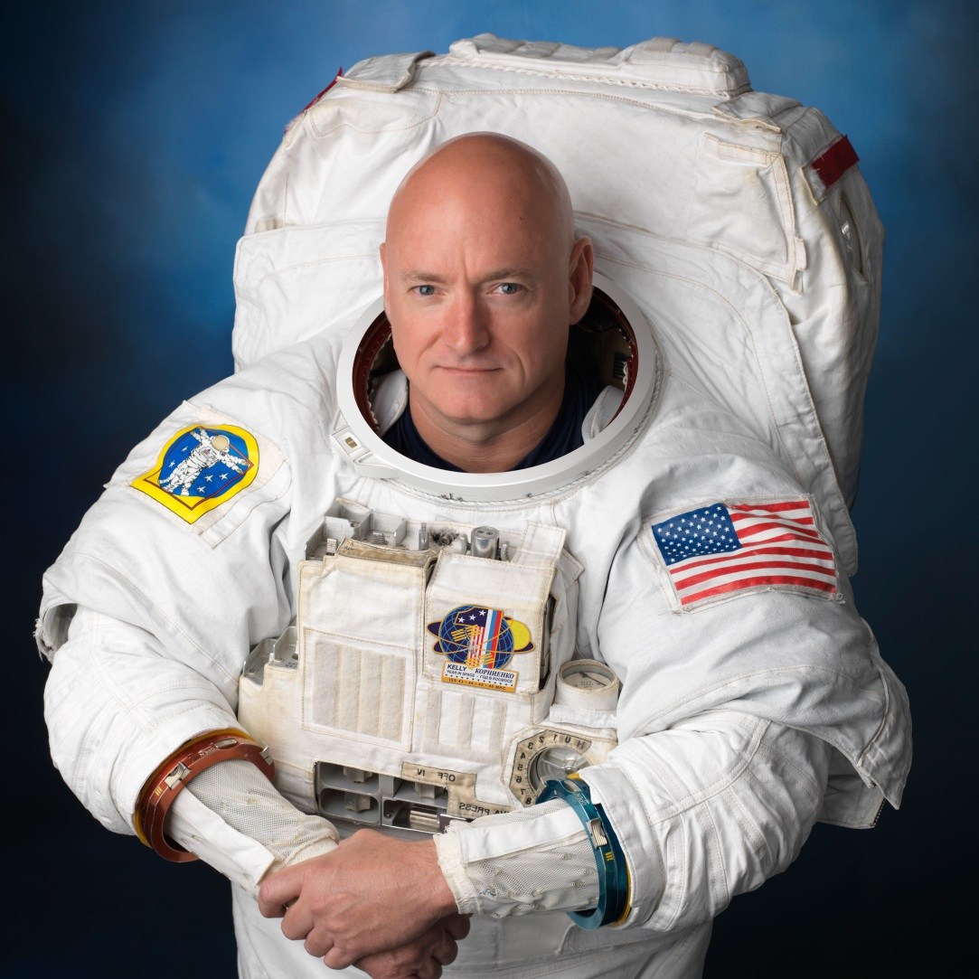
Celebrities who are Neurodiverse
Scott
Kelly
ADHD

Slide 26
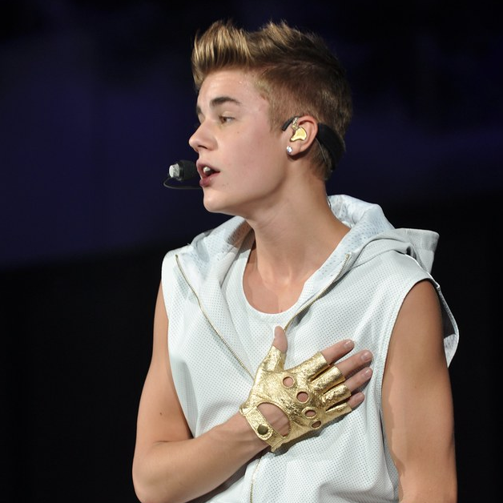
Celebrities who are Neurodiverse
Justin Bieber
ADHD

Slide 27
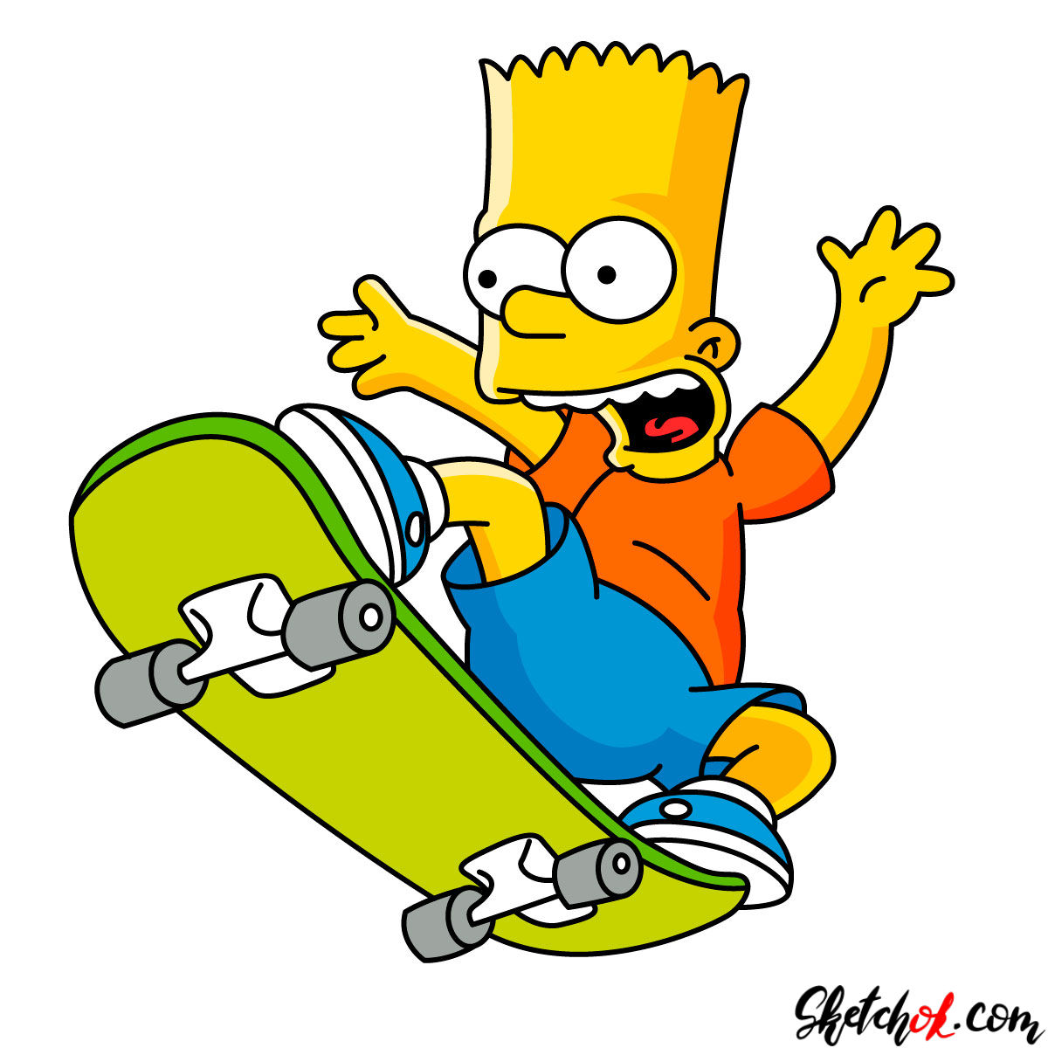
Celebrities who are Neurodiverse
Bart Simpson
ADHD

Slide 28
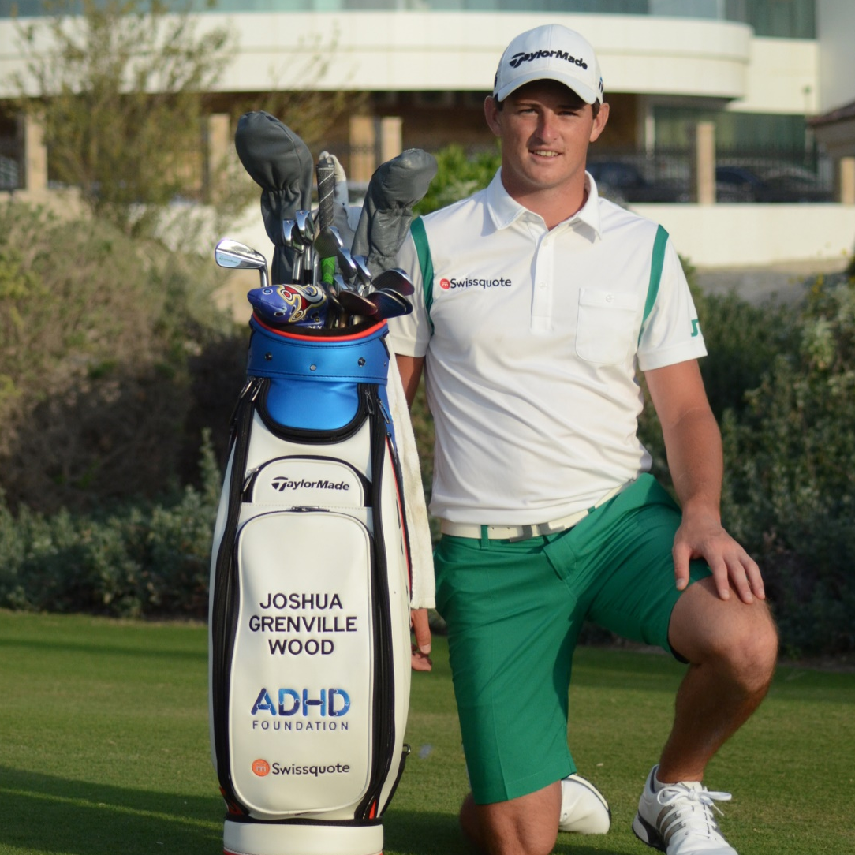
Young Neurodiversity Ambassadors
Josh Grenville-Wood
World Ranked Professional Golfer
ADHD and Dyslexia

Slide 29
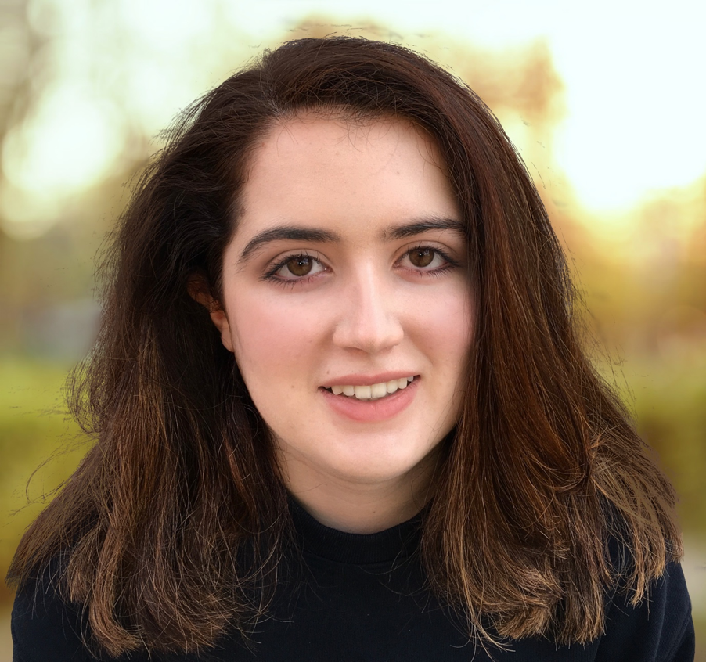
Young Neurodiversity Ambassadors
Siena Castellon
Founder of ‘Neurodiversity Celebration Week’
ADHD, Autism and Dyslexia

Slide 30
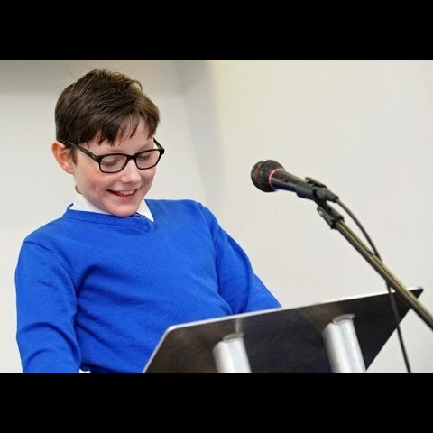
Young Neurodiversity Ambassadors
Marcus Wilton
Scored one of 2018’s top 10 SAT scores in the UK
ADHD, Autism and Dyslexia

Slide 31
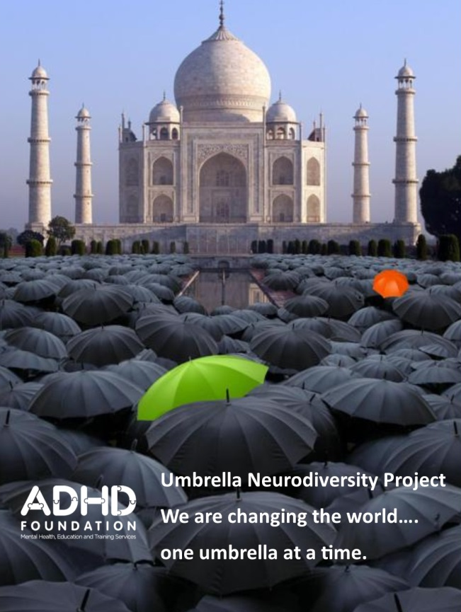
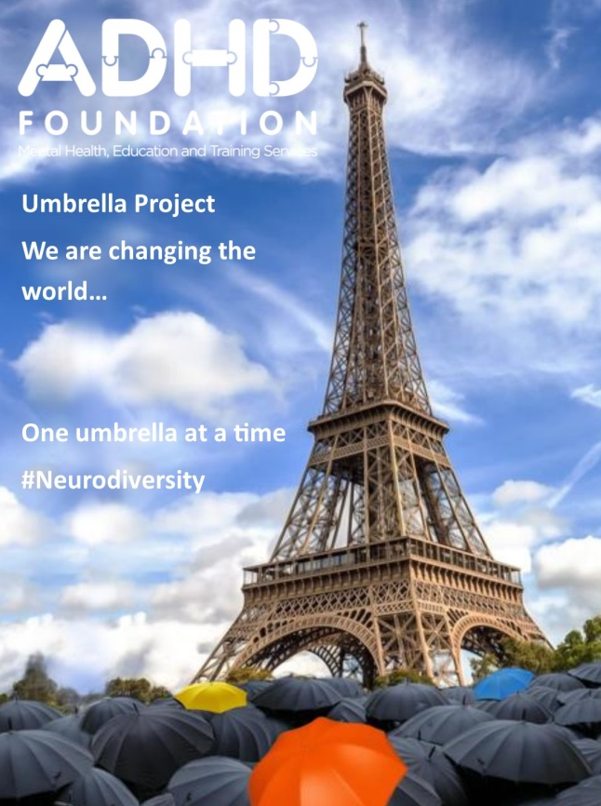
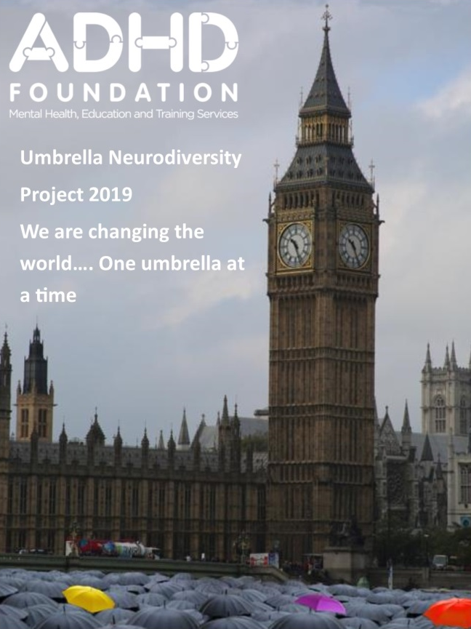
Share your Celebration with us
Let’s change the world, one umbrella at a time.
Send us your photos with you holding an umbrella, wherever you are in the world!
#umbrellas #neurodiversity #whatsyoursuperpower

