Slide 1

NEURODIVERSITY
CELEBRATION WEEK
WITH
Notes:
Neurodiversity Celebration Week
Introduce pupils to Neurodiversity week. A week of celebration with a focus on neurodevelopmental conditions and the strengths of those with these diagnoses. (Document attached to email about Sienna Castelon who developed the concept of neurodiversity week).

Slide 2
We are all different.
Notes:
We are all different.
An opportunity to reflect on the positives of being different.

Slide 3










People are different
Notes:
People are different – Skin colour, eye colour, hair colour and disability.

Slide 4





Brains are different too
Notes:
Brains are different too.
An opportunity to discuss how people’s brains may be different; meaning that they learn differently, behave differently, socialise differently etc.

Slide 5

Some disabilities look like this:
Some look like this:
Notes:
Some disabilities look like this: Some look like this.

Slide 6


Notes:
People all around the world have disabilities.
1.5 million people in the UK has a disability.
Neurodiversity week gives us the chance to learn more about a specific set of disabilities called Neurodevelopmental Conditions. This assembly will focus on ADHD, ASC, Dyslexia and Tourettes.

Slide 7

What is ADHD?
Attention
Deficit
?
Hyperactivity
Disorder
Notes:
What is ADHD? Attention, Deficit, Hyperactivity Disorder.

Slide 8
How can ADHD affect someone?
Difficult for them to concentrate in school
Need to move a lot
May find it difficult to organise themselves or their work
Easily distracted
May find it difficult to follow instructions
Lots of energy
Notes:
How can ADHD affect someone? – Difficult for them to concentrate in school, need to move a lot, may find it difficult to organise themselves or their work, easily distracted, may find it difficult to follow instruction, Lots of energy.

Slide 9

1 in 20 people have ADHD.
Notes:
1 in 20 people have ADHD.
That’s one person in every class.

Slide 10
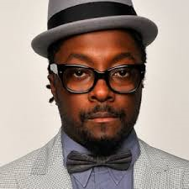
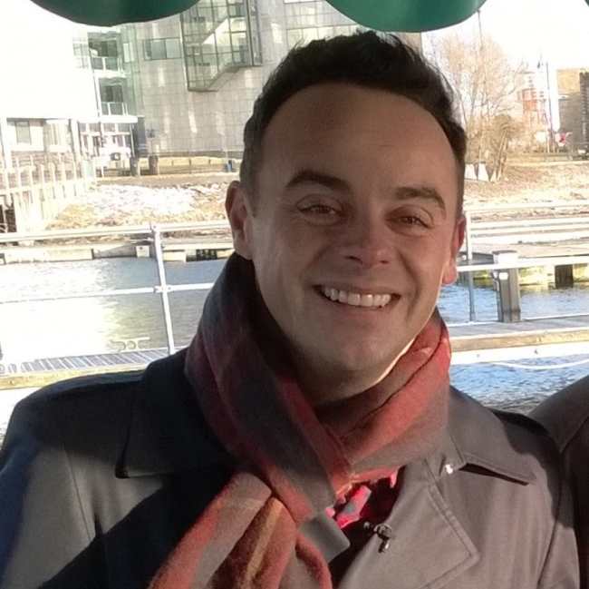
People with ADHD can do amazing things
Will.i.am is a singer and a judge on The Voice.
Ant McPartlin is a TV presenter from Britain’s Got Talent.
Notes:
People with ADHD can do amazing things – Justin Timberlake and Ant McPartlin.
This may be an opportunity for someone in the school community with ADHD to talk about their ADHD and how it has helps them to do amazing things. This person may be a Child, Teacher, Governor, Parent, Local business person etc. Anyone that has a positive story that can be shared about their own diagnosis.

Slide 11


People with ADHD can do amazing things
Michael Phelps is an Olympic swimmer, and has won 23 gold medals.
Robbie Williams is a singer and an X Factor judge.
Notes:
People with ADHD can do amazing things – Michael Phelps and Robbie Williams.

Slide 12
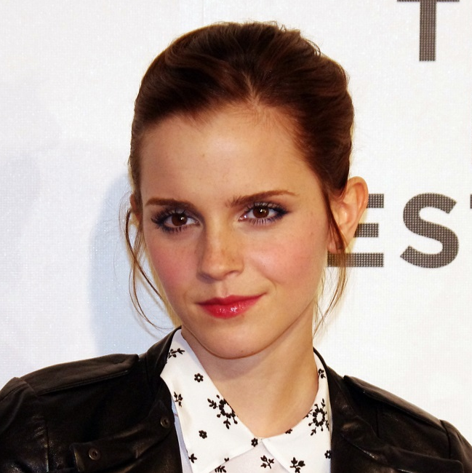

People with ADHD can do amazing things
Emma Watson is an actress and activist.
Simone Biles is an Olympic gymnast, and has won 4 gold medals.
Notes:
People with ADHD can do amazing things – Emma Watson and Simone Biles.
This may be an opportunity for someone in the school community with ADHD to talk about their ADHD and how it has helps them to do amazing things. This person may be a Child, Teacher, Governor, Parent, Local business person etc. Anyone that has a positive story that can be shared about their own diagnosis.

Slide 13

Michael Phelps – Talking Heads
Source: https://www.youtube.com/watch?v=XGynNTwUq3Y
Notes:
Michael Phelps – Talking Heads
Play video clip.

Slide 14
What is ASC?
Autistic
Spectrum
?
Condition
Notes:
What is ASC? Autistic Spectrum Condition
Some people call it Autism.

Slide 15
How can Autism affect someone?
May like to play on their own
May find talking to others difficult
Might not like loud noises
May like to play the same games without change
May get upset quickly
Notes:
How can Autism affect someone? – May like to play on their own, may find talking to others difficult, may not like loud noises, may like to play the same games without change, may get upset quickly.

Slide 16
1 in 100 people have Autism.
Notes:
1 in 100 people have Autism.
700,000 people in the UK have autism.

Slide 17

Source: http://amazingthingshappen.tv/
Notes:
What is Autism Video.
Play video clip.

Slide 18
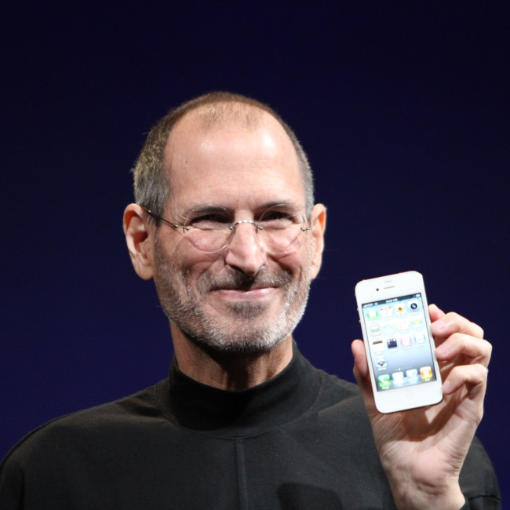
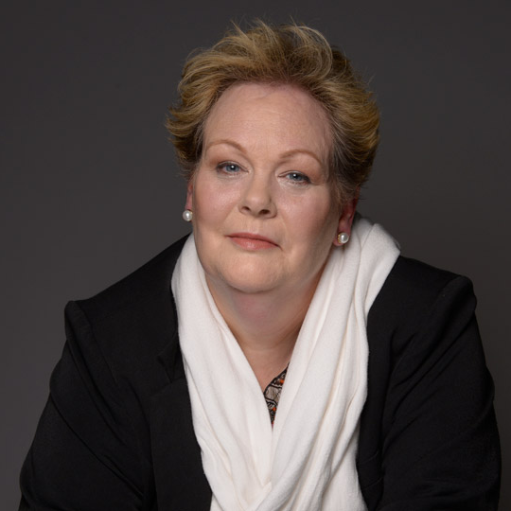
People with Autism can do amazing things
Steve Jobs was the founder of Apple.
Anne Hegerty is a Quiz Master on The Chase.
Notes:
People with Autism can do amazing things – Steve Jobs and Anne Hegerty.
This may be another opportunity for a member of the school community to speak about their own diagnosis of ASC. This person may be a Child, Teacher, Parent, Governor, Parent, Local business person etc. Anyone within the school community that can share a positive story about their ASC diagnosis and how it helps them to do amazing things.

Slide 19
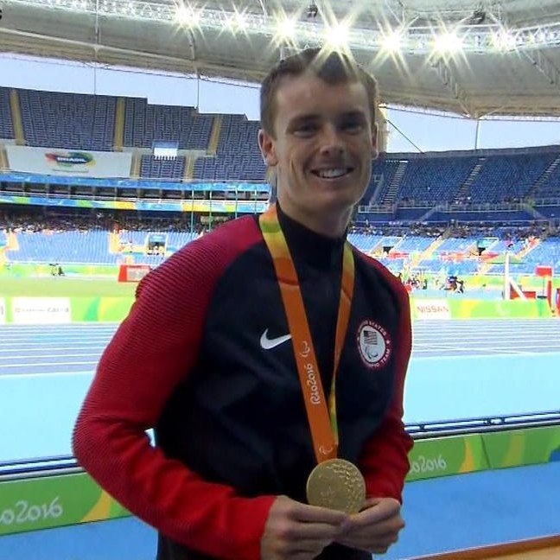
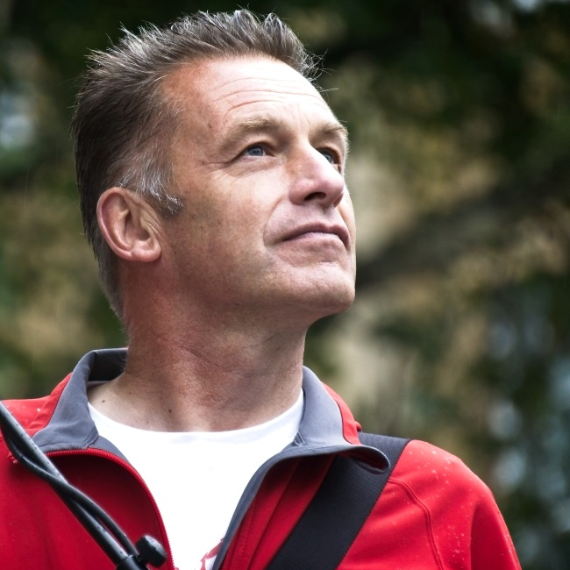
People with Autism can do amazing things
Mikey Brannigan is a Paralympic gold medal athlete.
Chris Packham is the presenter of Spring Watch.
Notes:
People with Autism can do amazing things – Mikey Brannigan and Chris Packham

Slide 20

What is Dyslexia?
?
Notes:
What is Tourette’s Syndrome?
Our brains are very, very busy things. Our brains tell our body what to do. For example, our brains tell our bodies when to breathe, which part to move, what to say and lot and lots of other things.
Because our brains are super busy telling every part of our body what to do, it has to have lots of helpers called Neuro-transmitters that go all over our bodies passing messages from our brains.
In people with Tourette’s Syndrome, these neuro-transmitters don’t work properly. This causes TICS.

Slide 21
How can Dyslexia affect someone?
May find it hard to read
May make spelling mistakes
Can be slow at writing
Can struggle to learn the name’s and sounds of letters
Might say things in the wrong order or hear sounds differently
Notes:
How can dyslexia affect someone – may find it hard to read, may make regular spelling mistakes, can be slow at writing, can struggle to learn the name’s and sounds of letters, might say things in the wrong order or hear sounds differently.

Slide 22
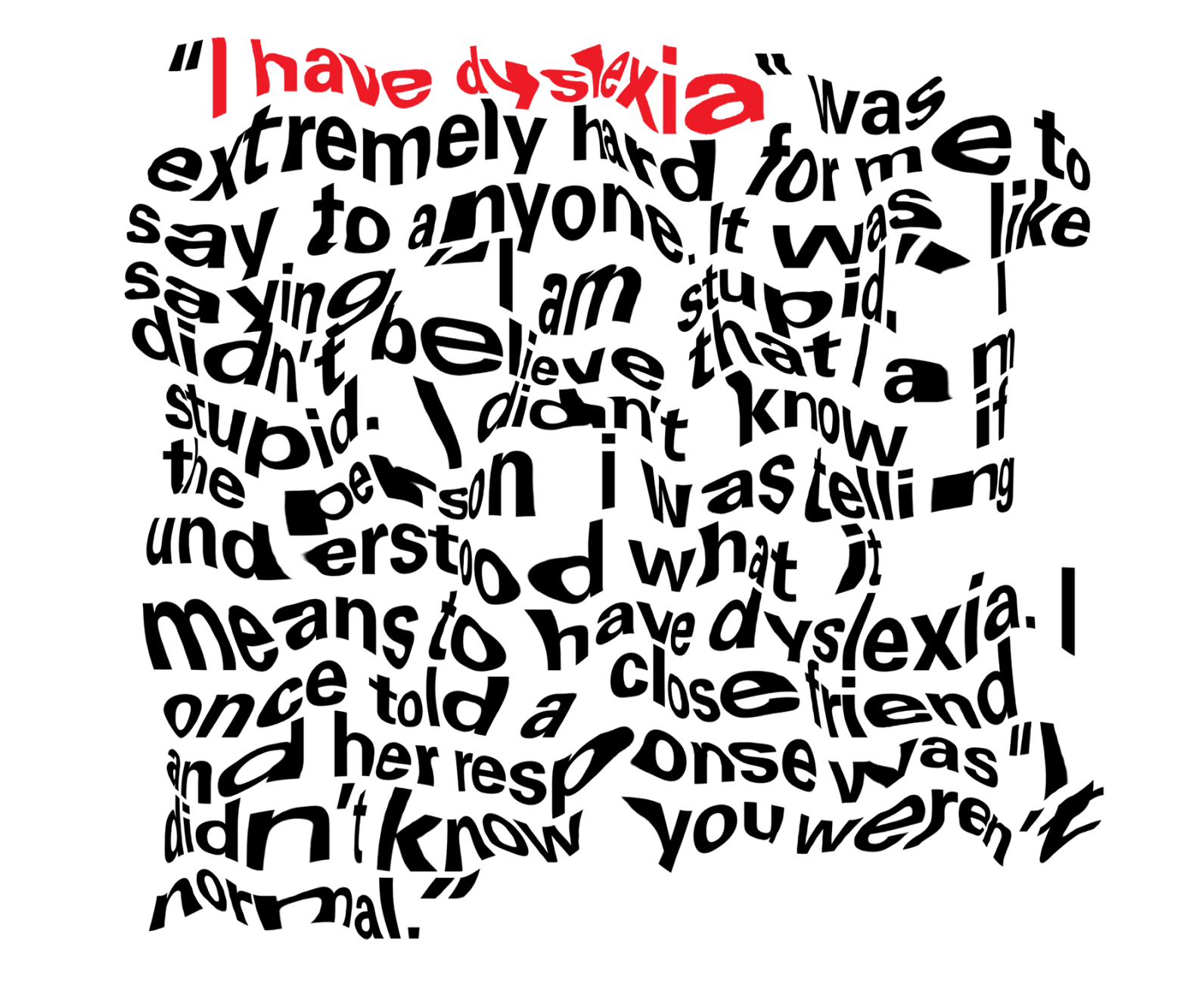
What Dyslexia can look like
Notes:
What Dyslexia can look like for a person with the condition.
For people with dyslexia, it can be hard to read lots of words on a page. Lots of people with dyslexia tell us that the words feel like they are jumping around on the page. People with Dyslexia also tell us that words can appear jumbled or the wrong way round which is confusing and makes reading very slow.

Slide 23
1 in 5 people have Dyslexia.
Notes:
1 in 5 people have dyslexia.
5 – 17% of school age children have dyslexia.

Slide 24
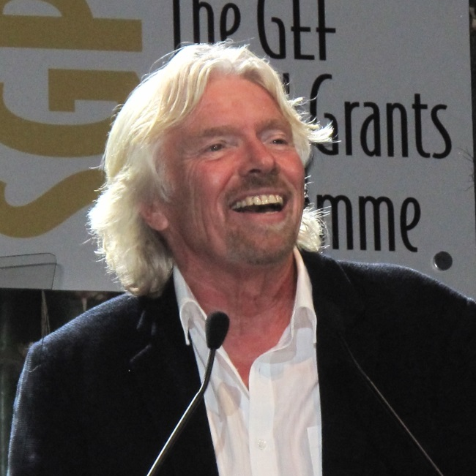

People with Dyslexia can do amazing things
Richard Branson is a business man, and founder of one of the world’s biggest airlines.
Will Smith is an actor, famous from Prince of Bel Air and Men in Black.
Notes:
People with Dyslexia can do amazing things – Richard Branson and Will Smith.
This may be another opportunity for a member of the school community to speak about their own diagnosis of ASC. This person may be a Child, Teacher, Parent, Governor, Parent, Local business person etc. Anyone within the school community that can share a positive story about their ASC diagnosis and how it helps them to do amazing things.

Slide 25
What is Tourette’s Syndrome?
?
Notes:
What is Tourette’s Syndrome?
Our brains are very, very busy things. Our brains tell our body what to do. For example, our brains tell our bodies when to breathe, which part to move, what to say and lot and lots of other things.
Because our brains are super busy telling every part of our body what to do, it has to have lots of helpers called Neuro-transmitters that go all over our bodies passing messages from our brains.
In people with Tourette’s Syndrome, these neuro-transmitters don’t work properly. This causes TICS.

Slide 26



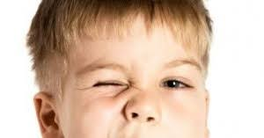
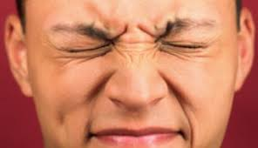
Motor Tics
TIC
TIC
TIC
TIC
TIC
Notes:
Motor Tics
Some people have twitches or movements that you can see – these are called motor tics.

Slide 27

Vocal Tics
*CLICK*
HELLO!
BANG
WOOF!
Notes:
Vocal Tics
Some people make sounds and noises that you can hear. These are called vocal tics.
People who have Tourette’s Syndrome do not do tics on purpose.

Slide 28
1 in 100 children have
Tourette’s Syndrome.
Notes:
1 in 100 children have Tourette’s Syndrome.

Slide 29












Tics can feel unpleasant
ITCHY
ELECTRICITY
FIZZY
BURNING
Notes:
Tics can feel unpleasant.

Slide 30


Trying to stop a tic hurts
Notes:
Trying to stop a tic hurts.
Ask the pupils - Try not blinking. You can do it for a short time, but the more you do it, the more it hurts. This is what trying to stop a tic is like.

Slide 31
What can I do if someone I know has Tourette’s Syndrome?
Don’t tease them about their Tics
Stand up for them if they are being bullied. Tell a teacher or another adult
Help them join in - don’t leave them out
Notes:
What can I do if someone I know has Tourette’s Syndrome? – Don’t tease them about their tics, stand up for them if they are being bullied by telling a teacher or another adult, Help them join in – don’t leave them out.

Slide 32
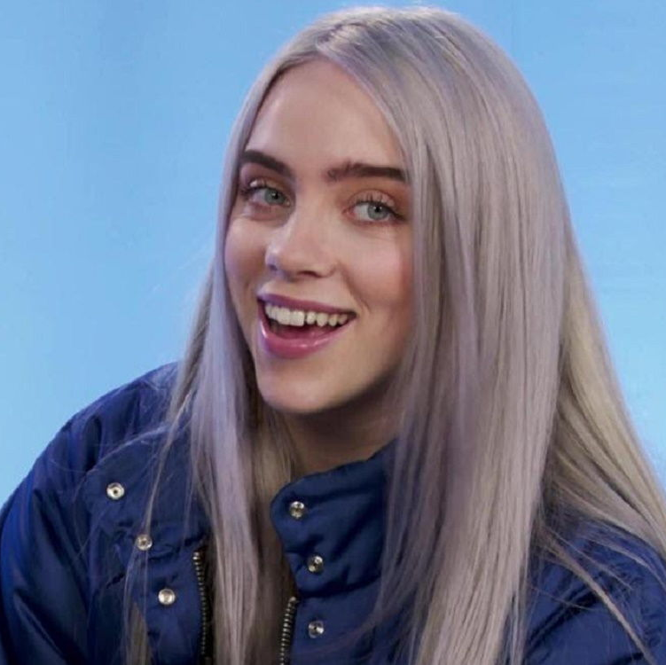
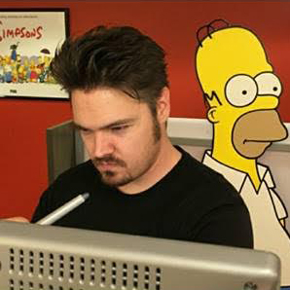
People with Tourette’s Syndrome can do amazing things
Billie Eilish is an American Singer and Songwriter.
Chance Raspberry is the Lead Animator for
The Simpsons.
Notes:
People with Tourette’s can do amazing things – Billie Eilish and Chase Raspberry.

Slide 33

Billie Eilish – Talking about Tourette’s Syndrome
Source: Ellentube (The Ellen Show 2019)
Notes:
Billie Eilish – Talking about Tourette’s Syndrome.
Play video clip

Slide 34

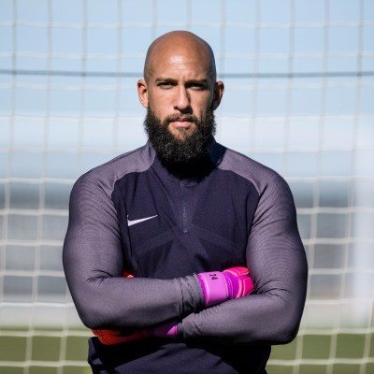
People with Tourette’s Syndrome can do amazing things
Dan Aykroyd is a famous actor, writer, musician and comedian.
Tim Howard is an International
Goalkeeper.
Notes:
People with Tourette’s Syndrome can do amazing things – Dan Aykroyd and Tim Howard.
This may be another opportunity for a member of the school community to speak about their own diagnosis of ASC. This person may be a Child, Teacher, Parent, Governor, Parent, Local business person etc. Anyone within the school community that can share a positive story about their ASC diagnosis and how it helps them to do amazing things.

Slide 35
What makes you amazing?

