Slide 1





The Neurodiversity Umbrella Project 2023
Neurodiversity is an umbrella
term for all kinds of minds

Slide 2
Who we are
The ADHD Foundation Neurodiversity Charity, based in Liverpool, is the largest user-led organisation of its kind in Europe, offering support to those with neurodevelopmental conditions such as ADHD, autism, dyslexia, dyspraxia, and Tourette’s Syndrome.

Slide 3

Who we are
What we do
The ADHD Foundation Neurodiversity Charity, based in Liverpool, is the largest user-led organisation of its kind in Europe, offering support to those with neurodevelopmental conditions such as ADHD, autism, dyslexia, dyspraxia, and Tourette’s Syndrome.
We offer a lifespan service, providing support to people from the Early Years through to adulthood.
Neurodiversity training for teachers, early years professionals, businesses, parents/ carers, healthcare workers, probation services and more.
Therapeutic services for school pupils and adults with neurodevelopmental conditions.
Private screening services.
We aim to create social change by working in partnership with agencies across all sectors (health, education, employment, justice).

Slide 4

Why umbrellas?
Neurodiversity is an umbrella
term for all kinds of minds
We hope to shed light on the strengths that neurodiversity can bring, whilst acknowledging the associated difficulties.
Umbrella displays are a great way for schools and businesses to show their support!

Slide 5

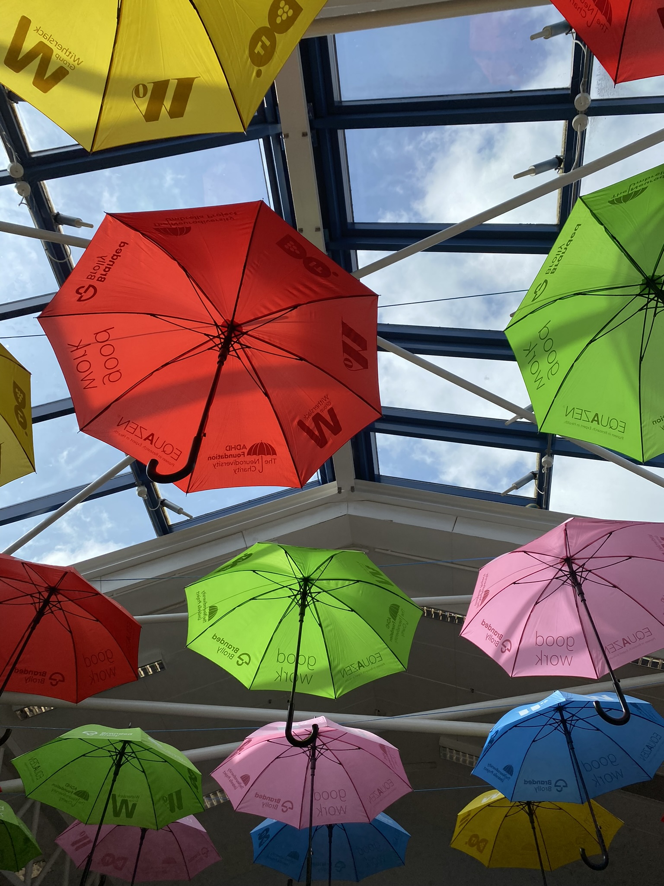
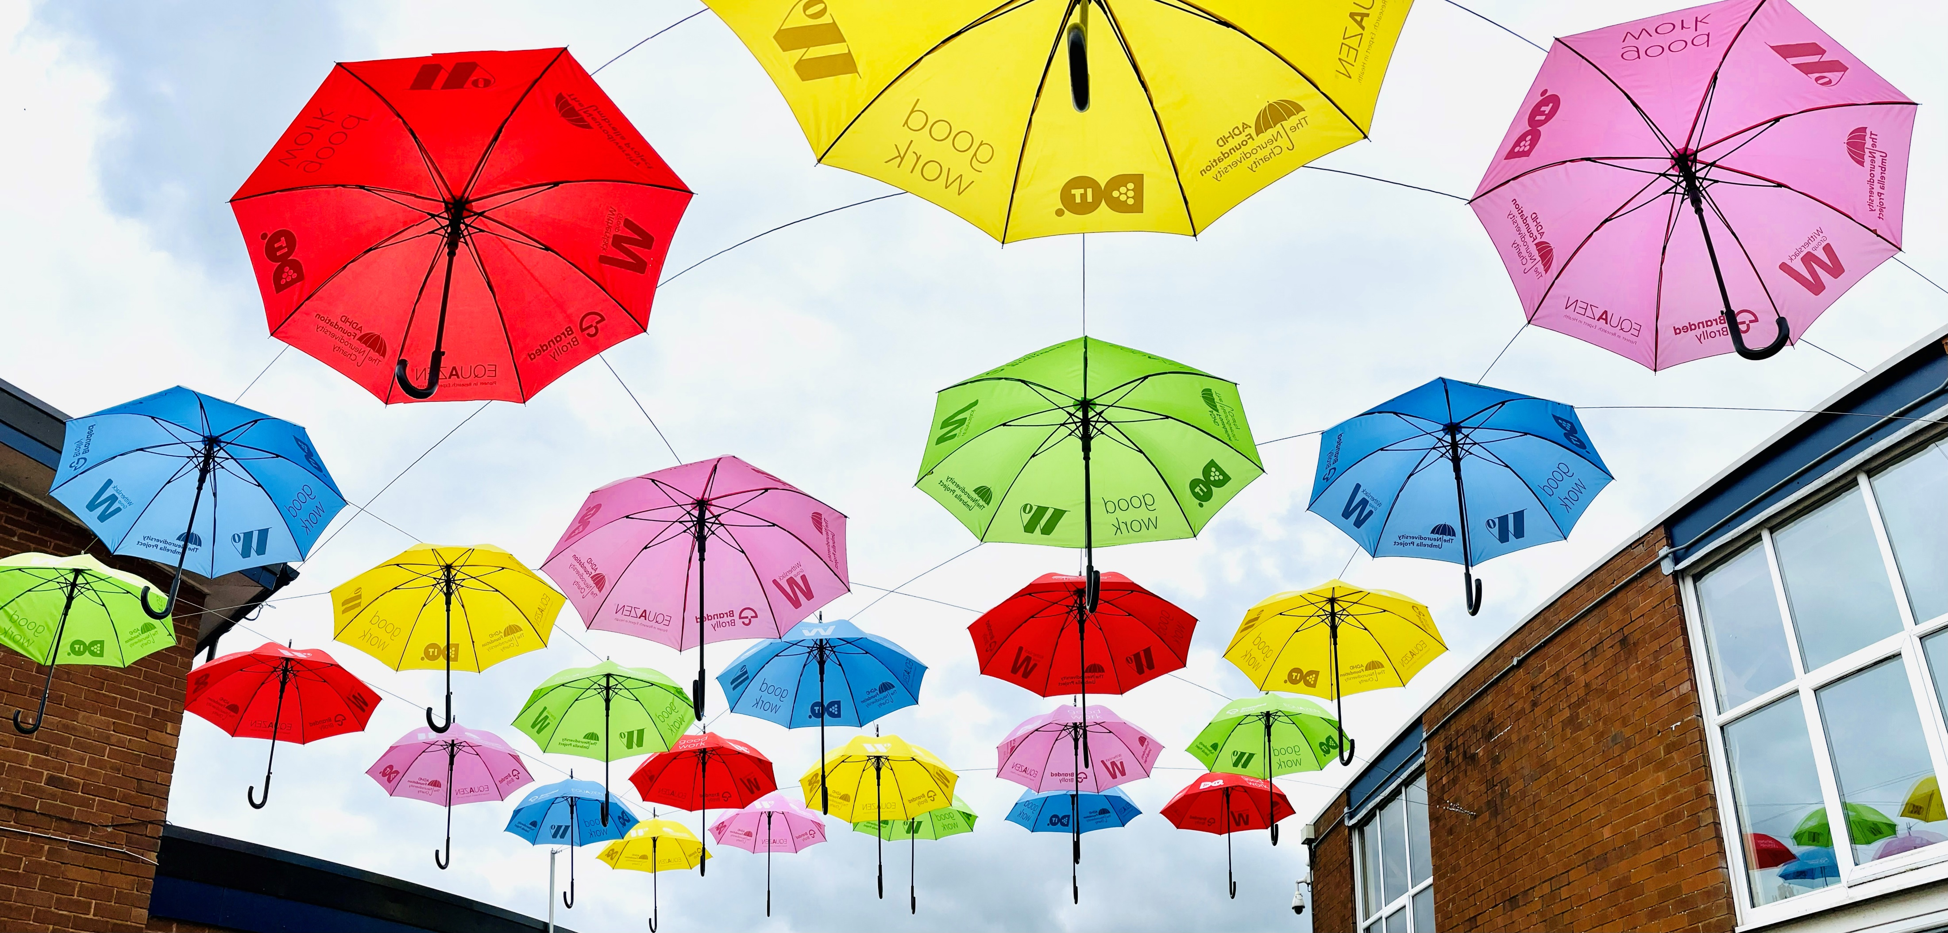
Examples
We love seeing the creative ways that different places choose to display their umbrellas.
Show us your pictures!
Tag us on social media at @adhdfoundation, or send your shots through to NDumbrellaproject@
adhdfoundation.org.uk.

Slide 6



Useful information
Box of 25 Umbrellas
Exclusive Resources
Training Webinars for Staff

Slide 7
Each umbrella has a hole drilled in the top to hang
You can keep umbrellas to reuse next year
Five colours: blue, yellow, green, red, orange

Slide 8
Each umbrella has a hole drilled in the top to hang
You can keep umbrellas to reuse next year
Five colours: blue, yellow, green, red, orange
Use our resources to explain the project to students and staff
Including assemblies, lesson plans, activities, quizzes, and more
Print out and put information near your display or in the classroom
Page updated with new information throughout the project cycle!

Slide 9
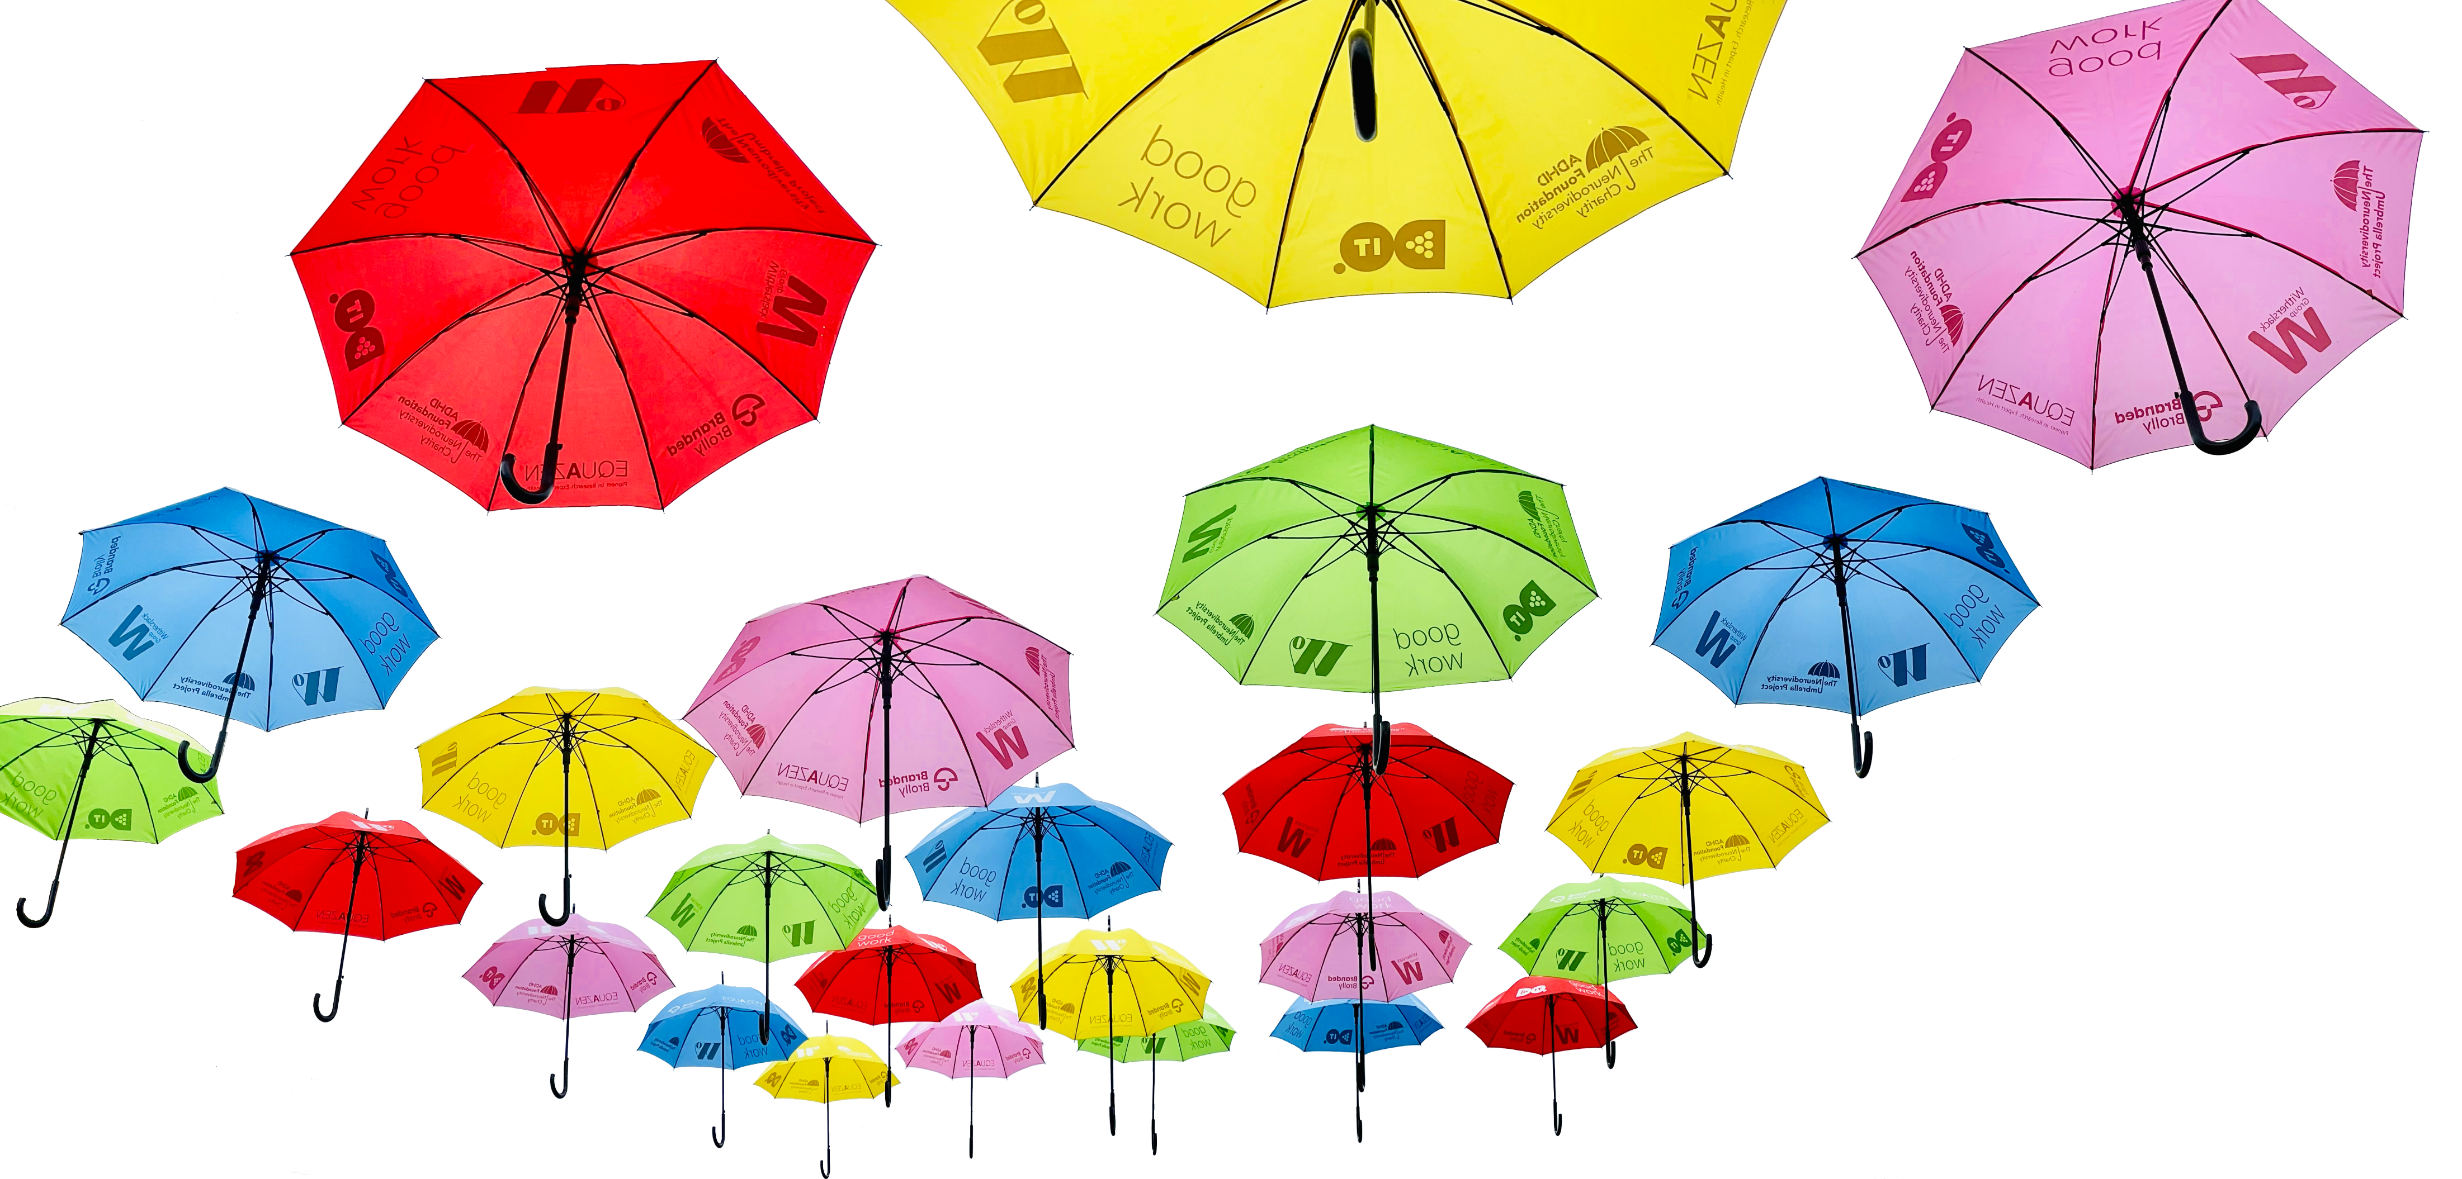
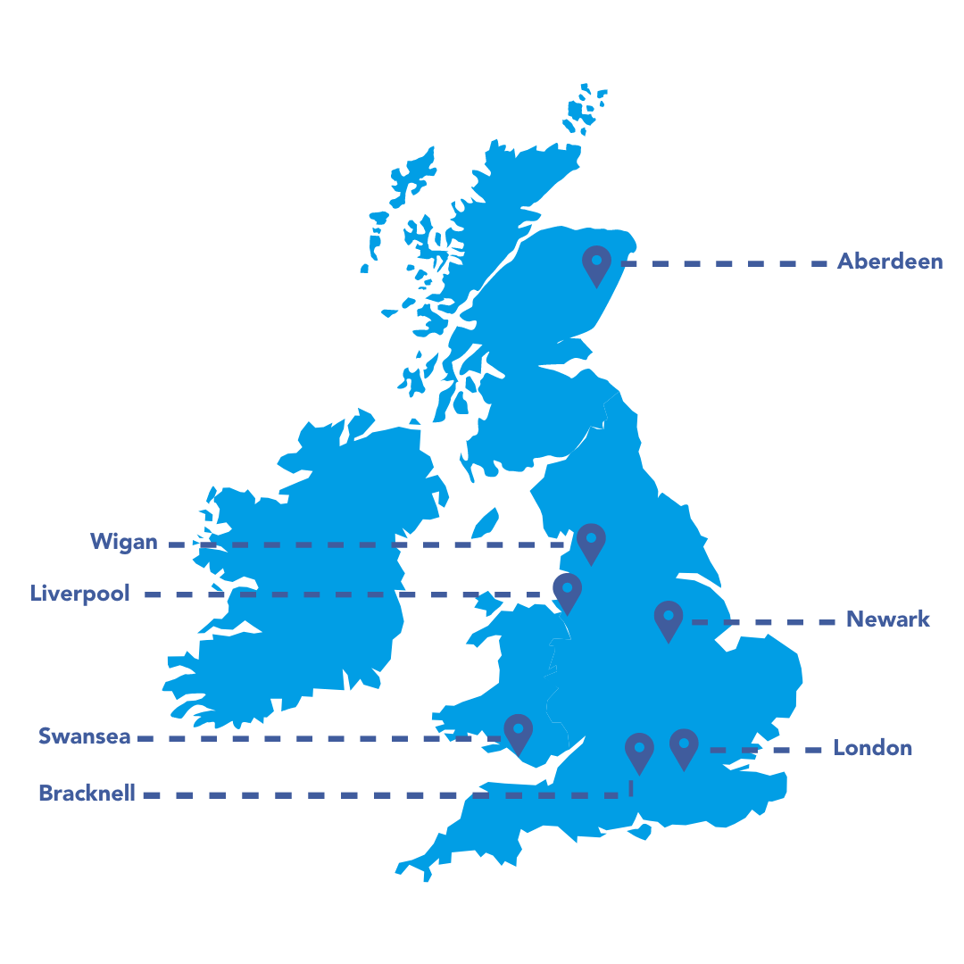
Each umbrella has a hole drilled in the top to hang
You can keep umbrellas to reuse next year
Five colours: blue, yellow, green, red, orange (no pink)
Use our resources to explain the project to students and staff
Including assemblies, lesson plans, activities, quizzes, and more
Print out and put information near your display or in the classroom
Page updated with new information throughout the project cycle!
Locations
‘Introduction to Neurodiversity’ training webinars for all staff
Wednesday 7th June and Tuesday 26th June at 15:00
An introduction to our many training options for education
Recorded and available to watch after the event

Slide 10
Locations
of public installations

Slide 11
Thanks for taking part!
We can’t wait to see your display.

