Slide 1
The Neurodiversity Umbrella Project 2023

Slide 2
Have you seen something like this?
What do you think the umbrellas mean?

Slide 3
What do you notice about the picture?
What's the same and what's different?

Slide 4
Difference
Some people in the picture have similarities
However, they also have lots of differences, just like everyone!
We use the word 'Neurodiversity' to describe brain differences
What do you think we mean by brain differences?

Slide 5
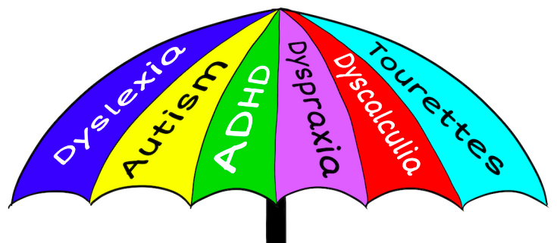
Neurodiversity
This is called an 'Umbrella Term'
This is because it is used to describe lots of differences in the brain
Some of these differences have names
1 in 5 of us have these differences

Slide 6
Thinking Time
Do you think being different is a good thing or a bad thing?

Slide 7
Neurodiverse people can be…
Fun to be with​
Creative
Kind​
Great friends
Fearless
Courageous​
Intelligent
Imaginative​
Funny
Quick-witted
Enthusiastic
Driven

Slide 8
Thinking Time
Do you think a person with one of these conditions can be successful?

Slide 9
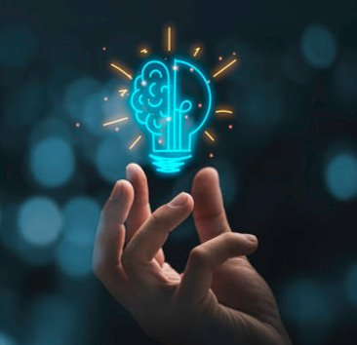
Yes they can!
It’s great to be different!
Michael Phelps has ADHD​
Billie Eilish has Tourette's Syndrome​
Michael Jordan has ADHD​
Daniel Radcliffe has Dyspraxia​
Simone Biles has ADHD​
Emma Watson has ADHD​
Greta Thunberg has Autism​
Richard Branson has Dyslexia​
Lewis Capaldi has Tourette’s Syndrome​
Tom Holland has Dyslexia​

Slide 10
Celebrate Neurodiversity
The umbrellas are a way of celebrating neurodiversity and difference! Remember...

Slide 11
It’s Great to be Different!
Wouldn’t life be boring if we were all the same?

