Slide 1





The Neurodiversity Umbrella Project 2024

Slide 2
Have you seen something like this?
What do you think the umbrellas mean?

Slide 3
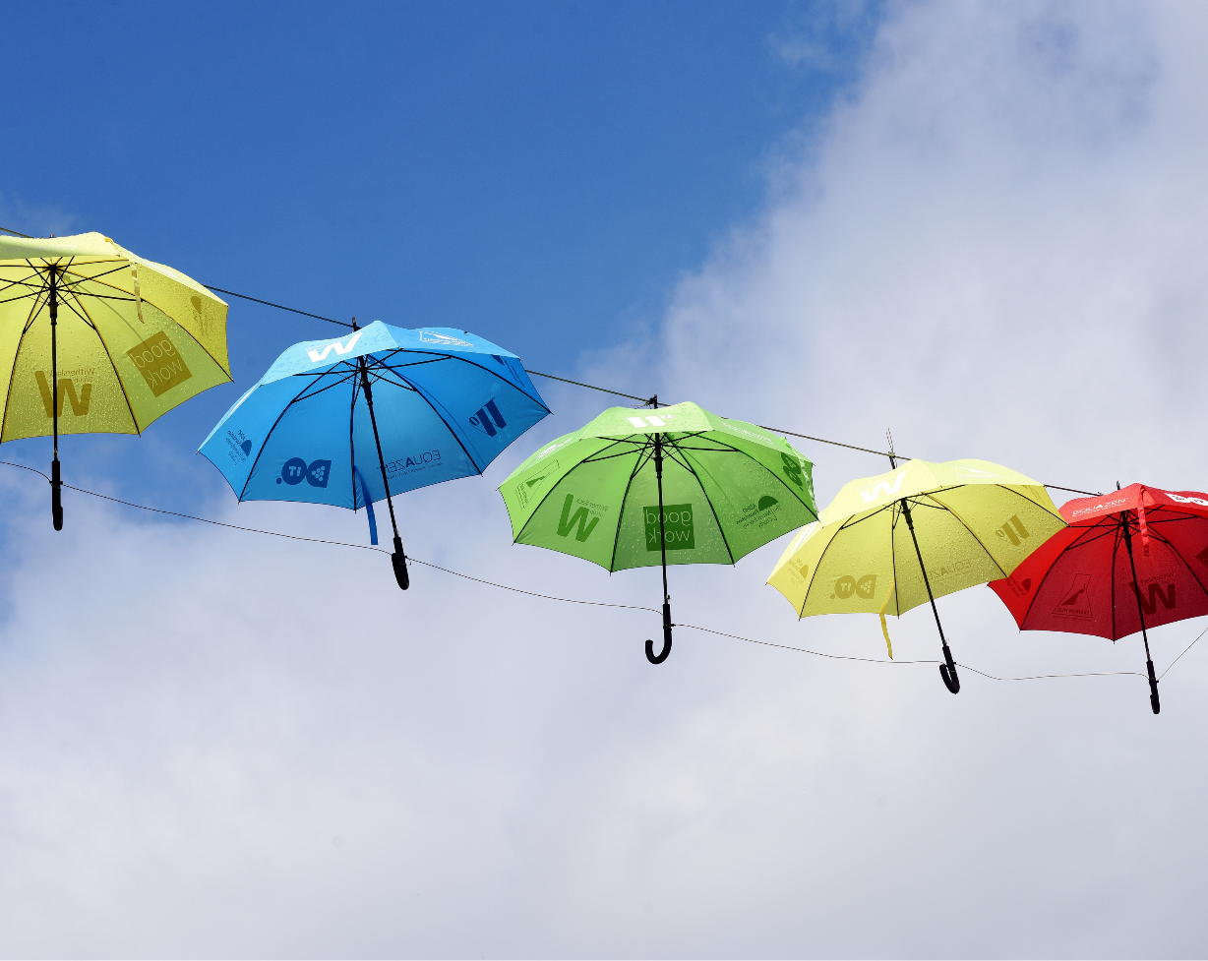
The Neurodiversity Umbrella Project
Every Umbrella Project installation helps to raise awareness and understanding of neurodiversity.
Thousands of colourful umbrellas are displayed together over public spaces, in schools, and in company buildings around the nation.
Each display is designed to represent the one in five of us who have a neurodevelopmental condition, such as ADHD, Autism, Dyslexia, Dyspraxia, Dyscalculia or Tourette’s syndrome.
These conditions fall under the umbrella term of neurodivergence/neurodiversity.

Slide 4
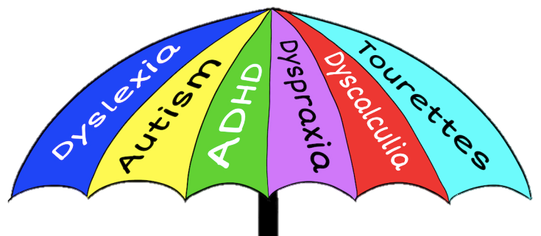
Neurodiversity
This is called an 'Umbrella Term'
This is because it is used to describe lots of differences in the brain
Some of these differences have names
1 in 5 of us have these differences

Slide 5
Thinking Time
Do you have any experience of neurodiversity?

Slide 6
Neurodiverse people can be…
Fun to be with​
Creative
Kind​
Great friends
Fearless
Courageous​
Intelligent
Imaginative​
Funny
Quick-witted
Enthusiastic
Driven

Slide 7
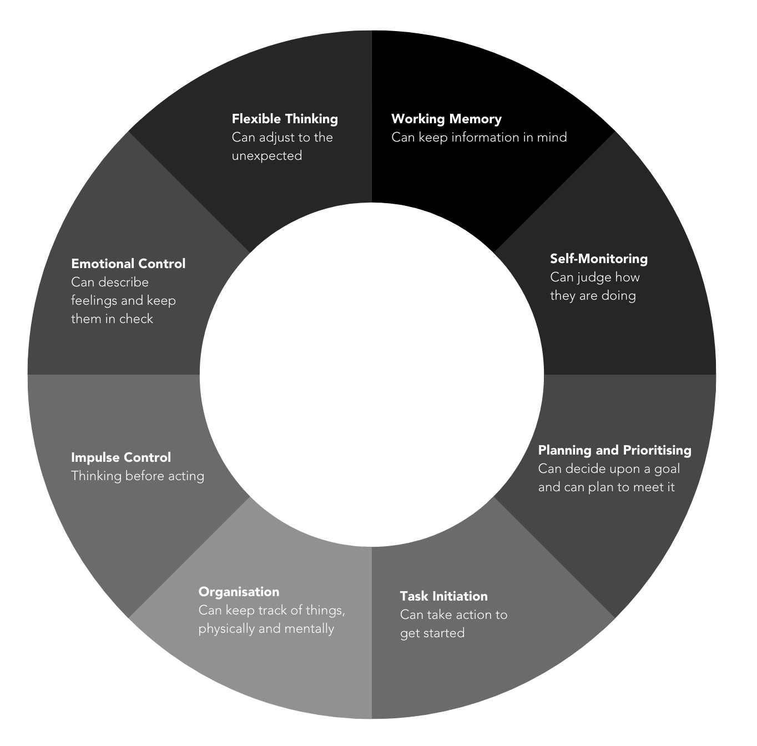
Executive Functioning

Slide 8
Thinking Time
Do you think a person with one of these conditions can be successful?

Slide 9

Yes they can!
It’s great to be different!
Michael Phelps has ADHD​
Billie Eilish has Tourette's Syndrome​
Michael Jordan has ADHD​
Daniel Radcliffe has Dyspraxia​
Simone Biles has ADHD​
Emma Watson has ADHD​
Greta Thunberg has Autism​
Richard Branson has Dyslexia​
Lewis Capaldi has Tourette’s Syndrome​
Tom Holland has Dyslexia​

Slide 10
Celebrate Neurodiversity
The umbrellas are a way of celebrating neurodiversity and difference! Remember...

Slide 11
It’s great to be different!
Wouldn’t life be boring if we were all the same?

